Slide 1
2020 Intertidal Seaweed Photos Table of Contents
June 2020 Cover
Four Tree Island………..………………………….. Slide 3-4
Cedar Point…………………………………………… Slide 5
Adams Point…………………………………………. Slide 6
Lubberland Creek…………………………………. Slide 7
Depot Road…………………………………………… Slide 8
August 2020 Cover + Biomass
Four Tree Island Cover…………………………….Slide 10-11
Four Tree Island Biomass…………………………Slide 12-13
Cedar Point Cover………………………………….. Slide 14
Cedar Point Biomass…………………………….... Slide 15
Adams Point Cover………………………………... Slide 16
Adams Point Biomass…………………………….. Slide 17
Lubberland Creek Cover…………………….…… Slide 18
Lubberland Creek Biomass…………………….. Slide 19
Depot Road Cover…………………………………. Slide 20
Depot Road Biomass……………………………… Slide 21
October 2020 Cover
Four Tree Island…………………………………..… Slide 23-24
Cedar Point …………………………………………… Slide 25
Adams Point………………………………………..… Slide 26
Lubberland Creek …………………………….…… Slide 27
Depot Road………………………………………..…. Slide 28

Slide 2
June 2020

Slide 3
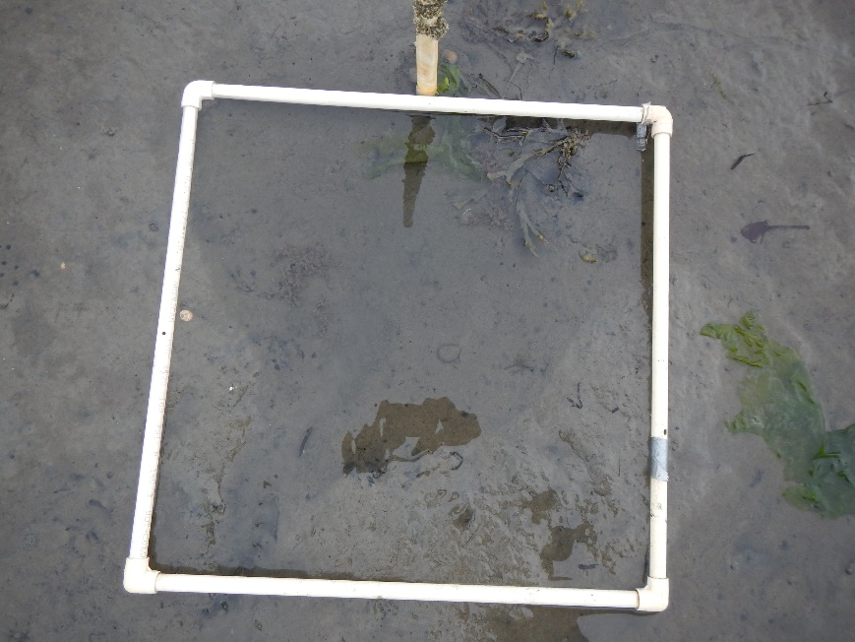
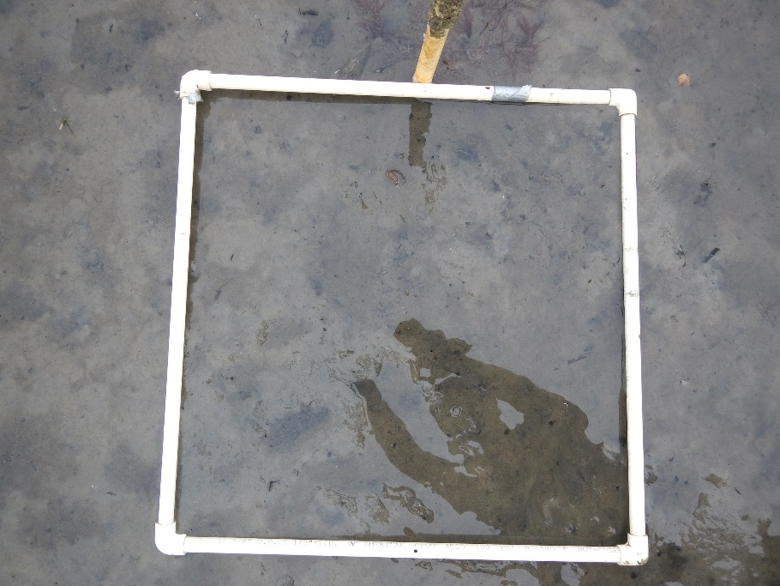
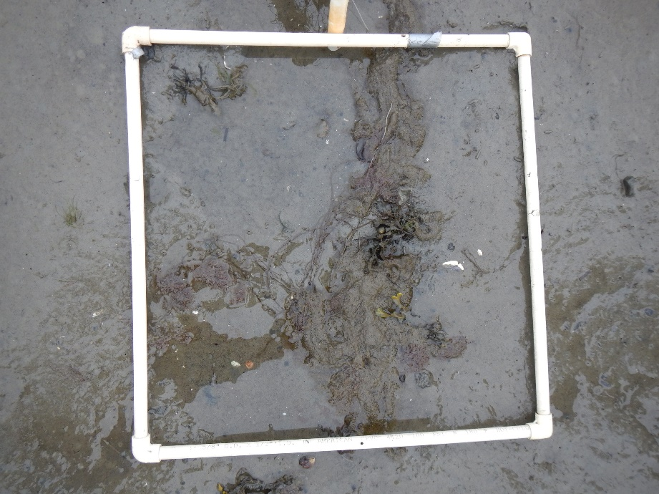
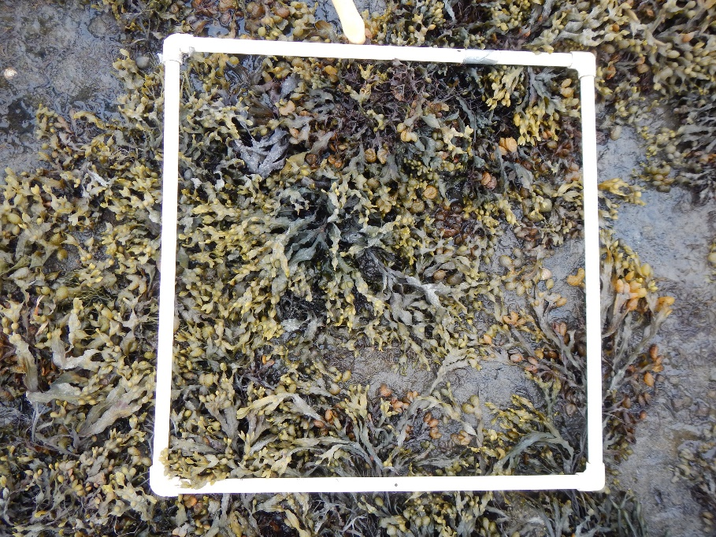
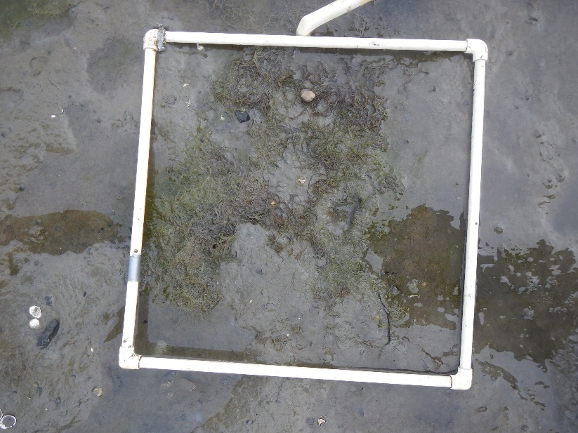
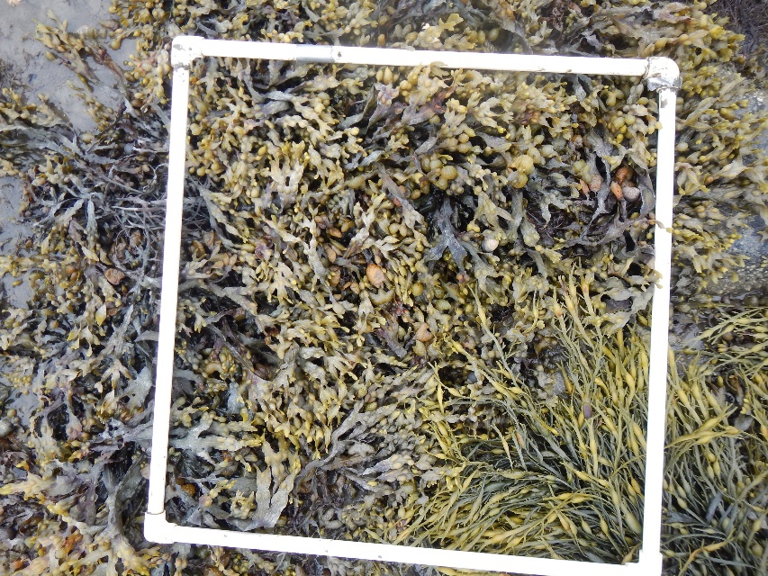
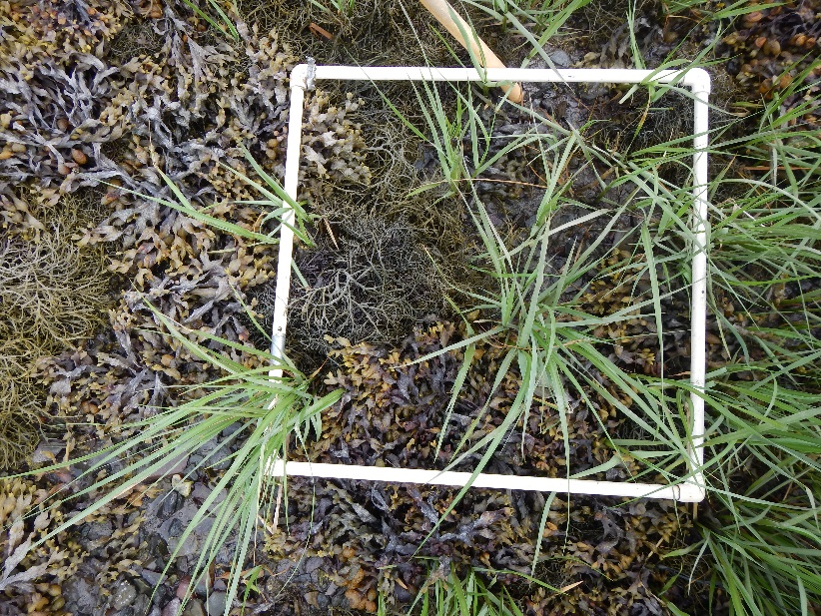
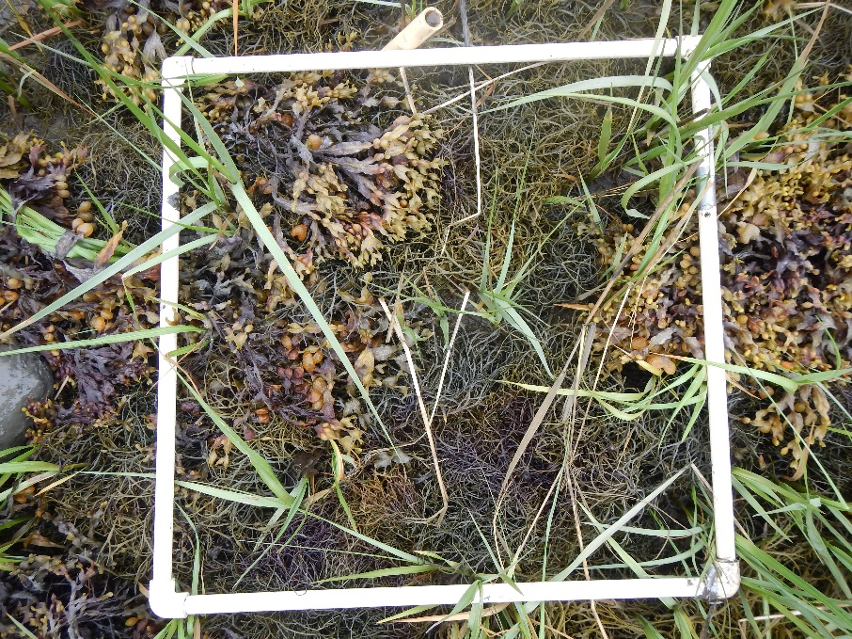
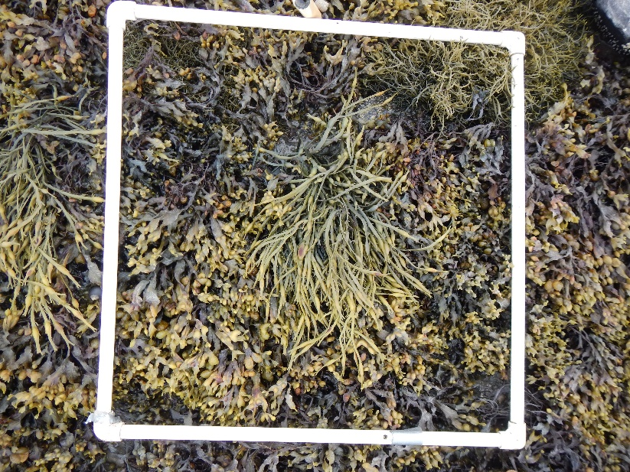
A
Site: 4TI
B
Date:
6/23/20
C
A-0.0
B-0.0
C-0.0
0.0
A-0.5
B-0.5
C-0.5
0.5
A-1.0
B-1.0
C-1.0
1.0

Slide 4
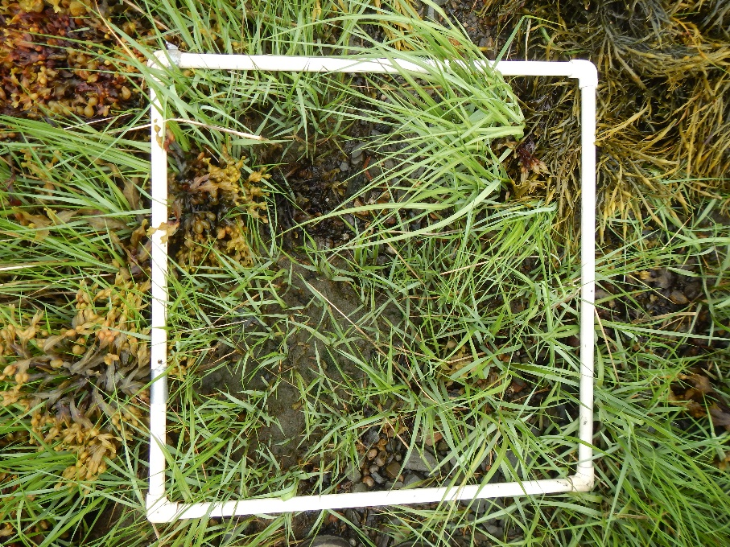
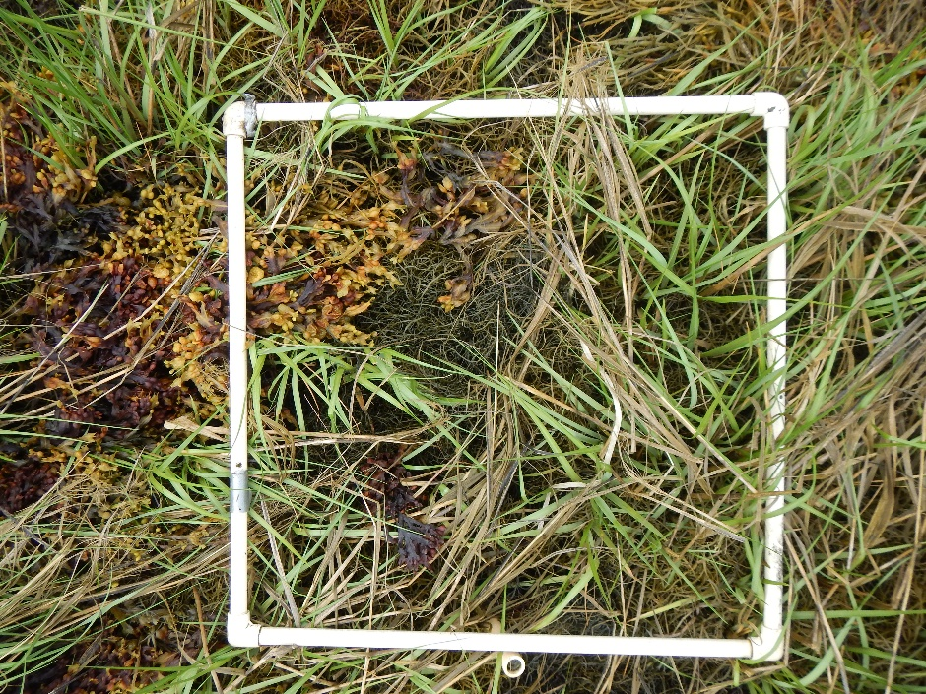
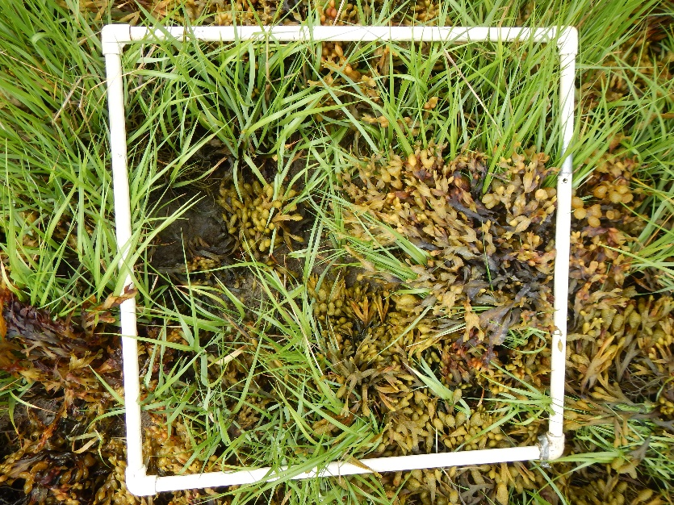
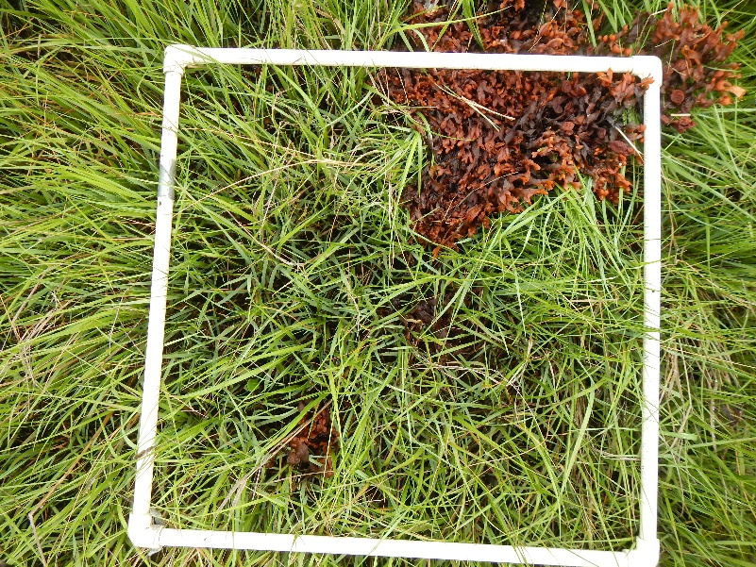
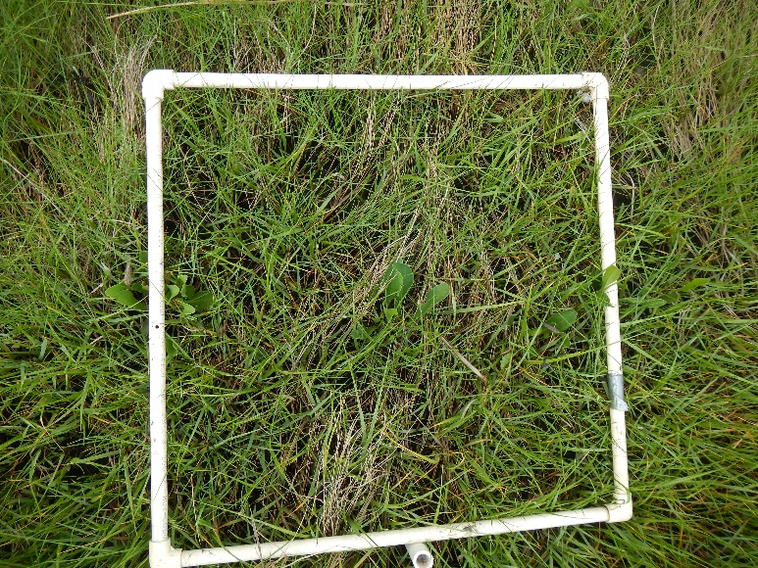
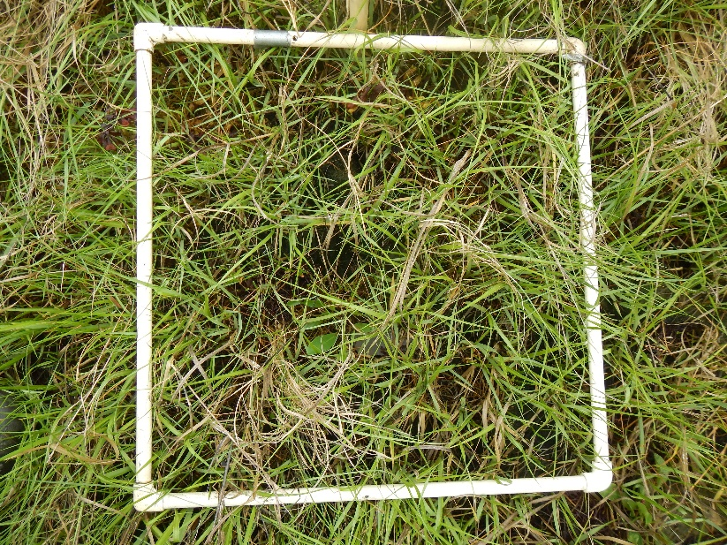
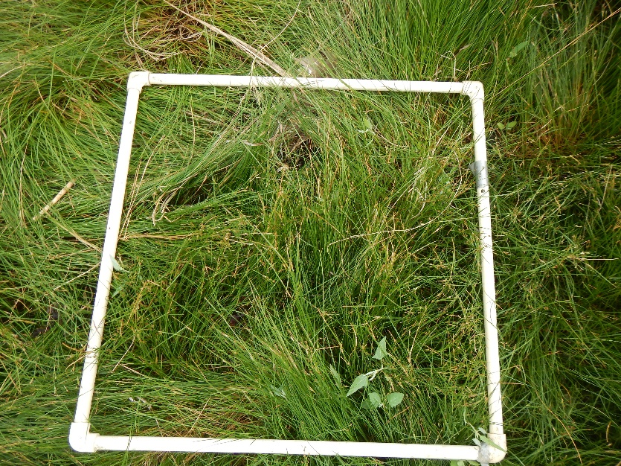
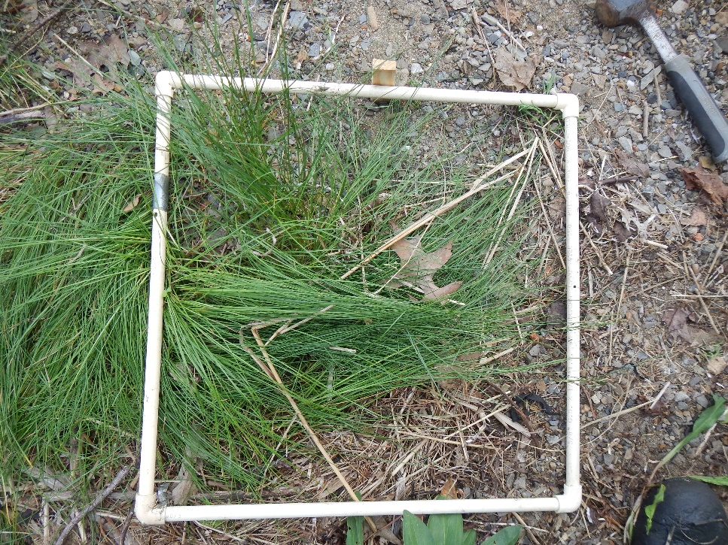
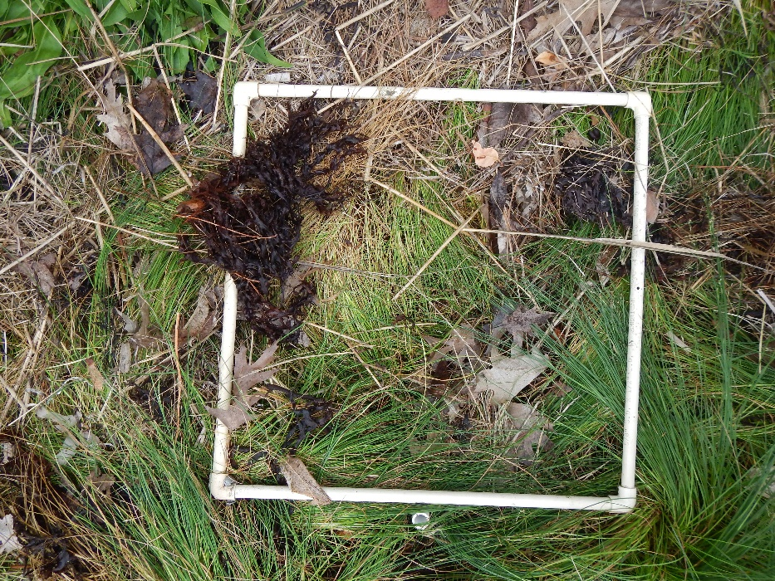
A
Site: 4TI
B
Date:
6/23/20
C
A-1.5
B-1.5
C-1.5
1.5
A-2.0
B-2.0
C-2.0
2.0
A-2.5
B-2..5
C-2.5
2.5

Slide 5
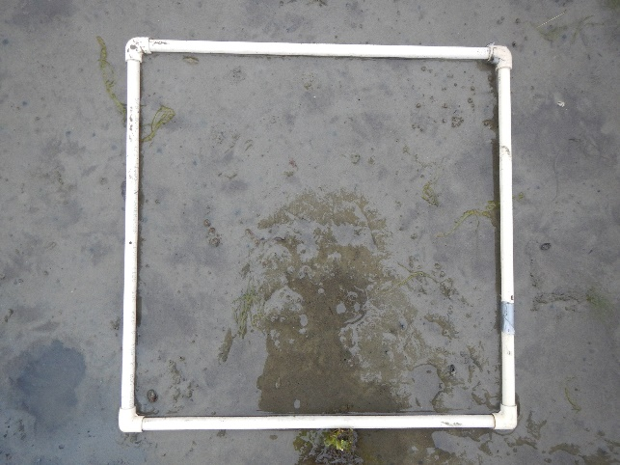
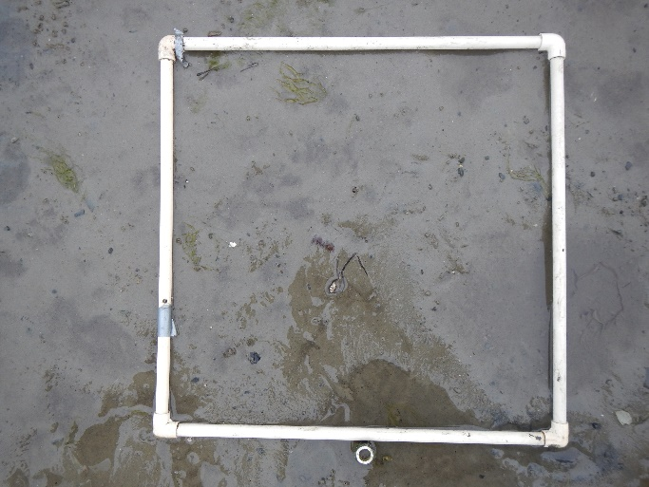
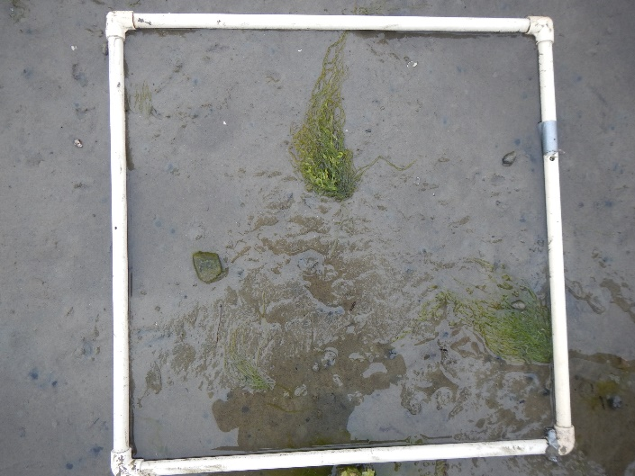
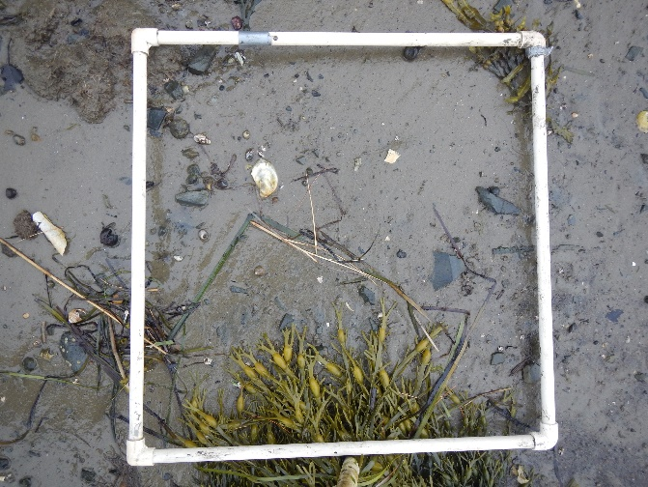
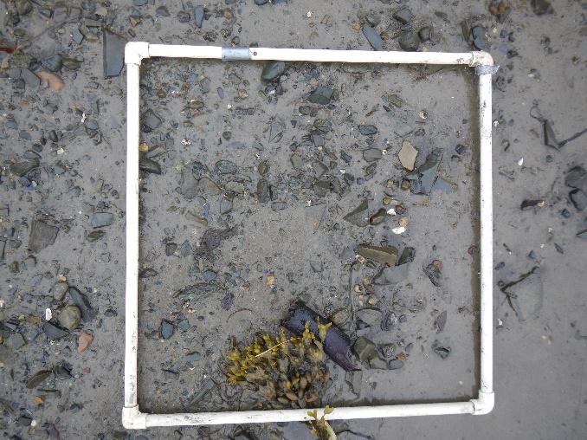
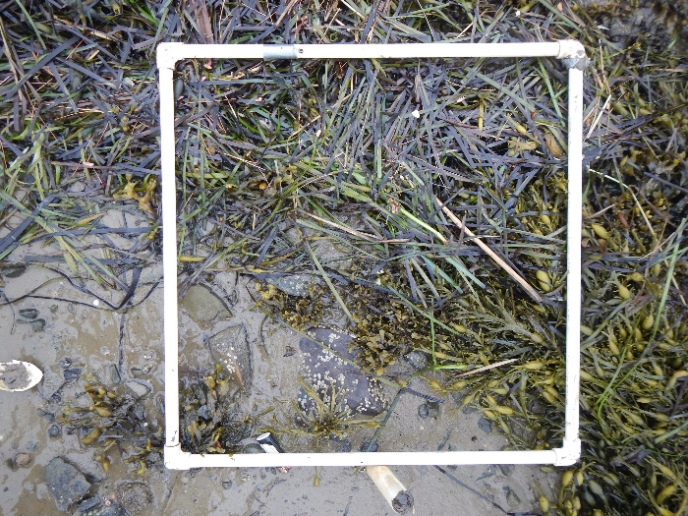
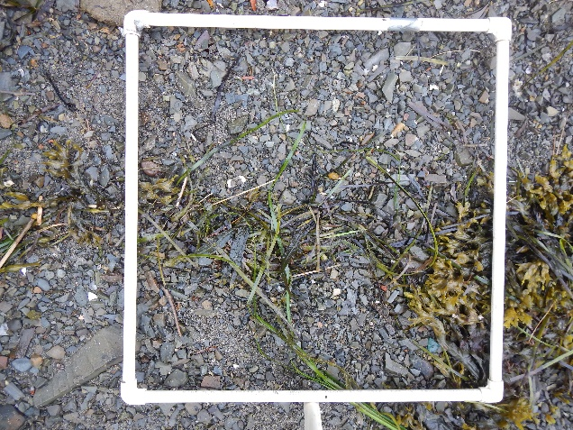
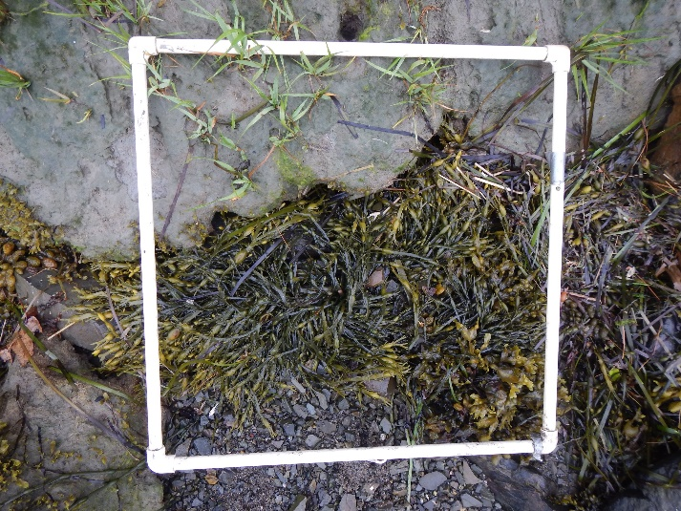
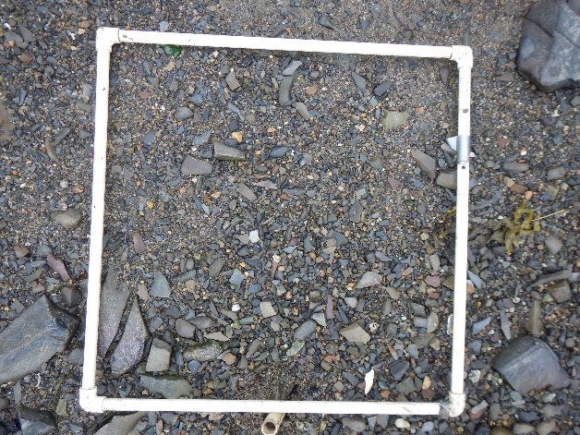
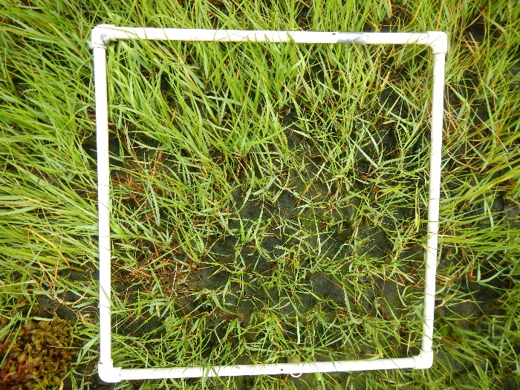
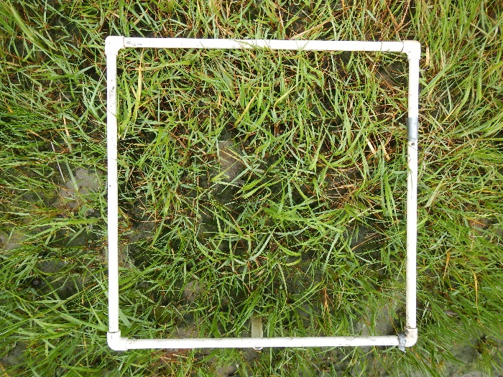
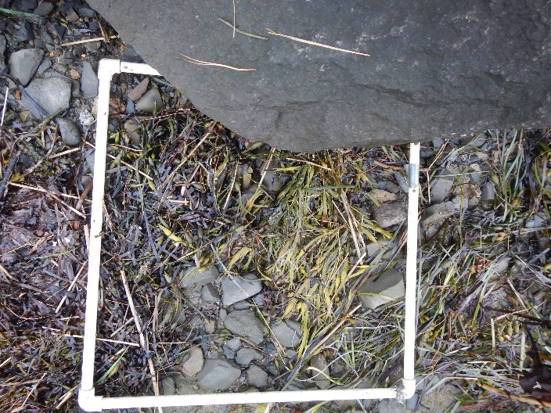
A
Site: CP
B
Date:
6/22/20
C
A-0.0
B-0.0
C-0.0
0.0
A-0.5
B-0.5
C-0.5
0.5
A-1.0
B-1.0
C-1.0
1.0
A-1.5
B-1.5
C-1.5
1.5

Slide 6
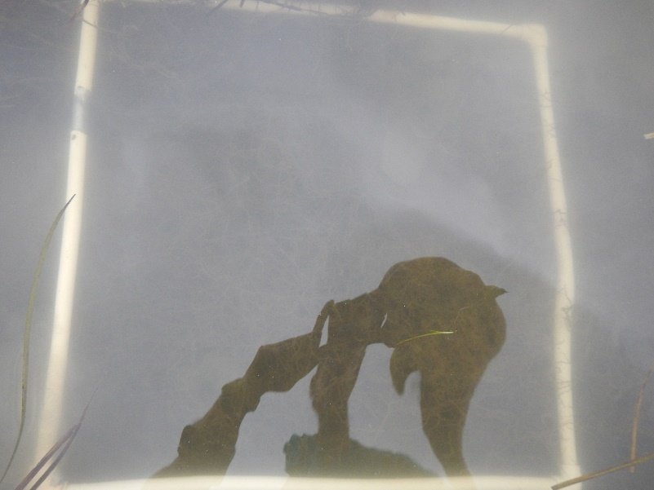
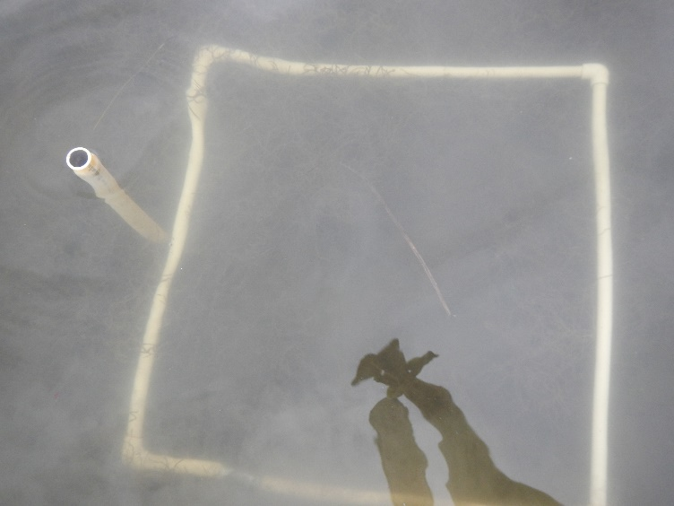
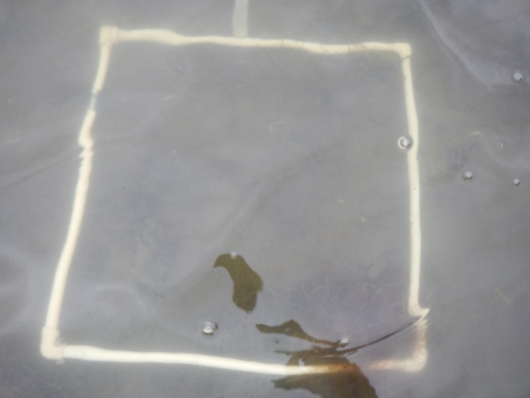
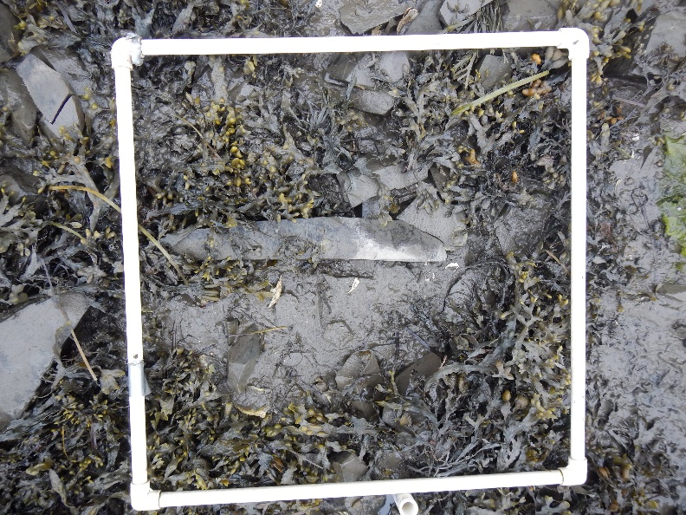
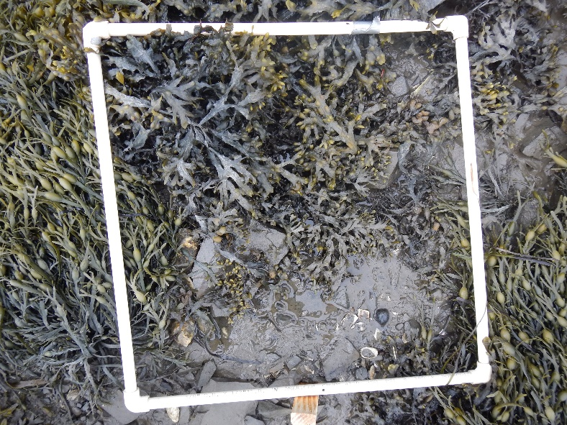
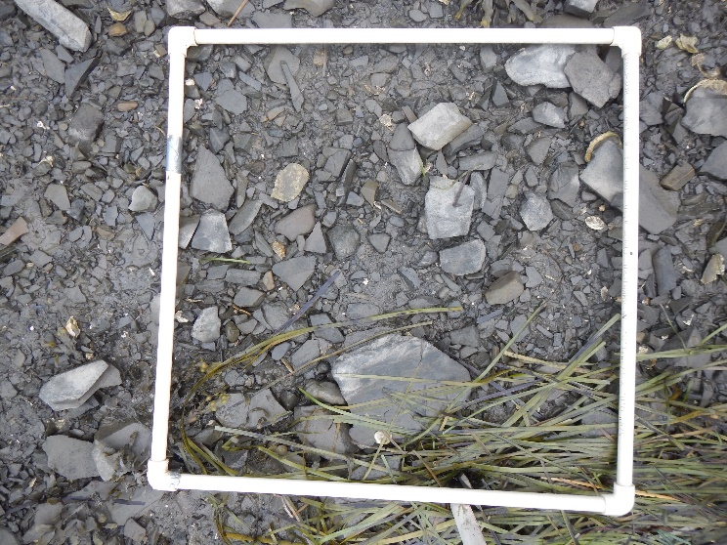
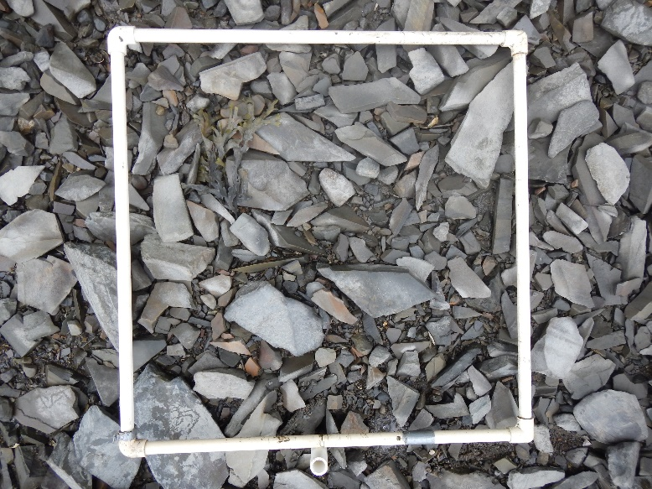
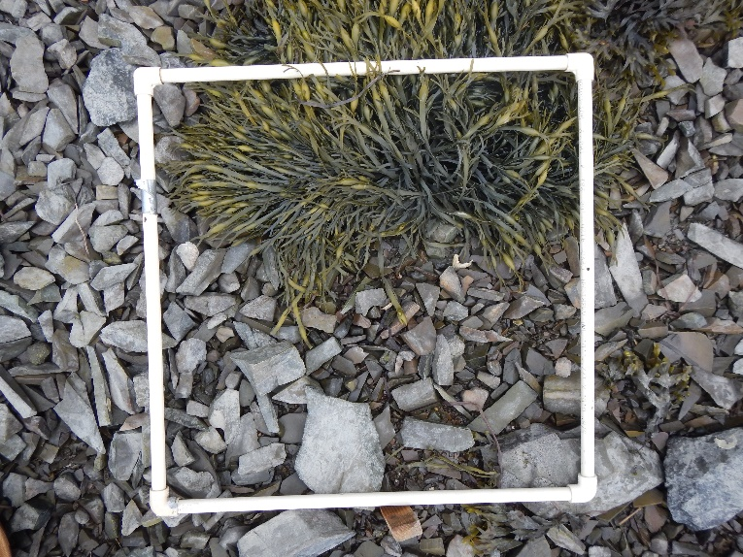
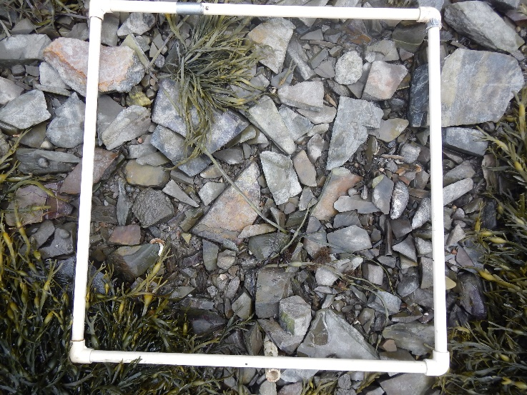
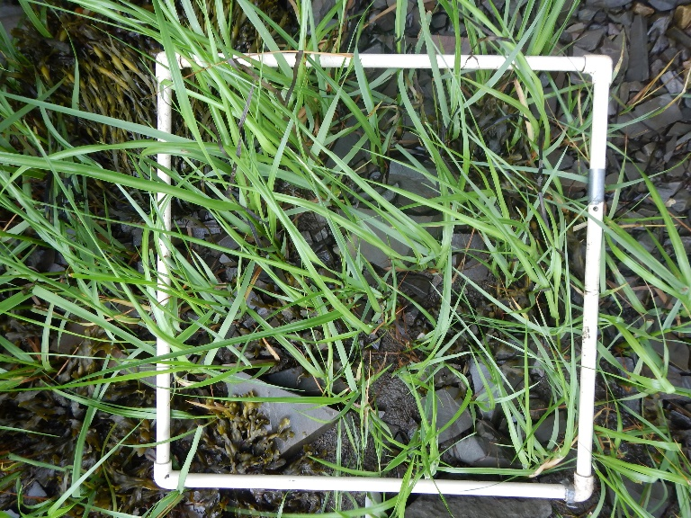
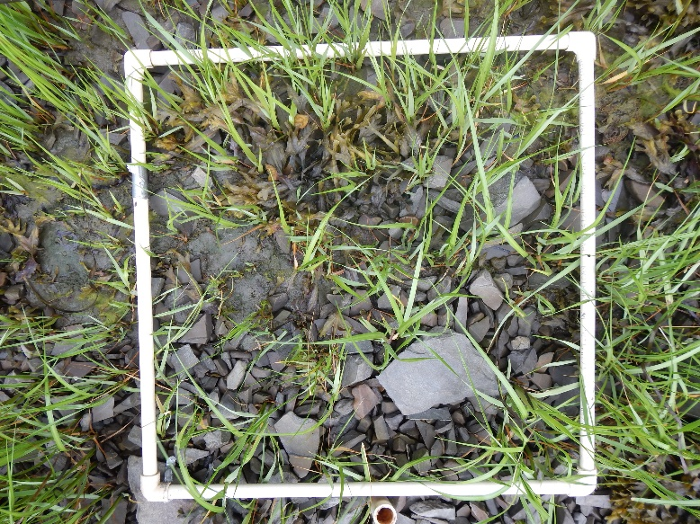
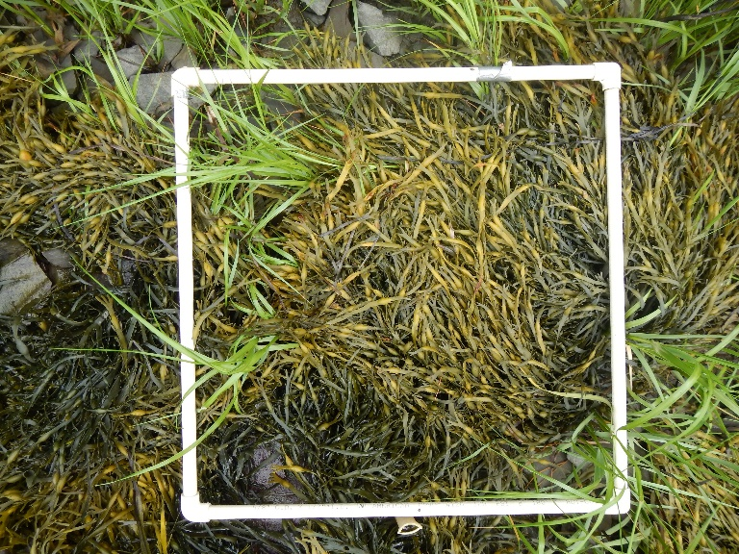
A
A-1
B
B-1
C
C-1
Site: AP
Date:
6/24/20
0.0
A-2
B-2
C-2
0.5
A-3
B-3
C-3
1.0
A-4
B-4
C-4
1.5

Slide 7
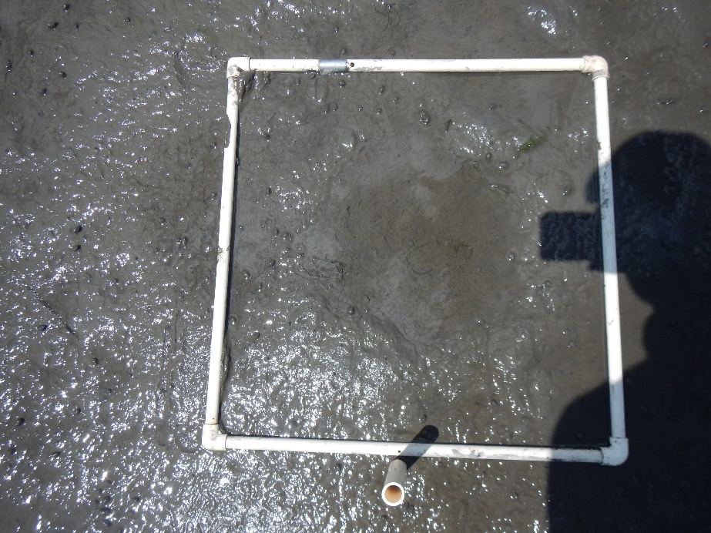
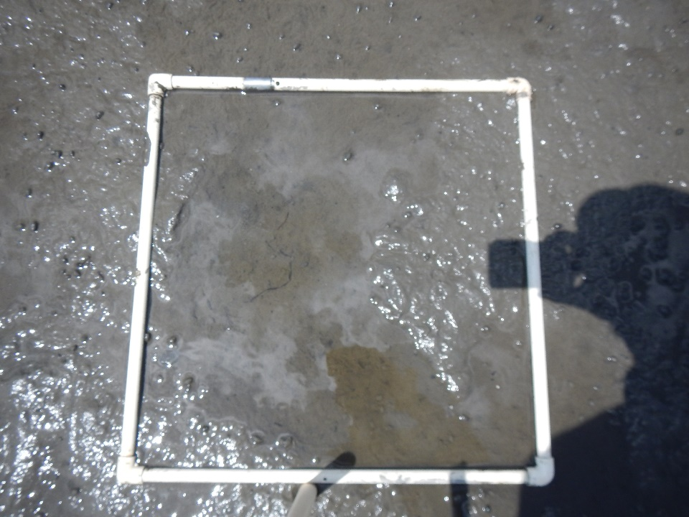
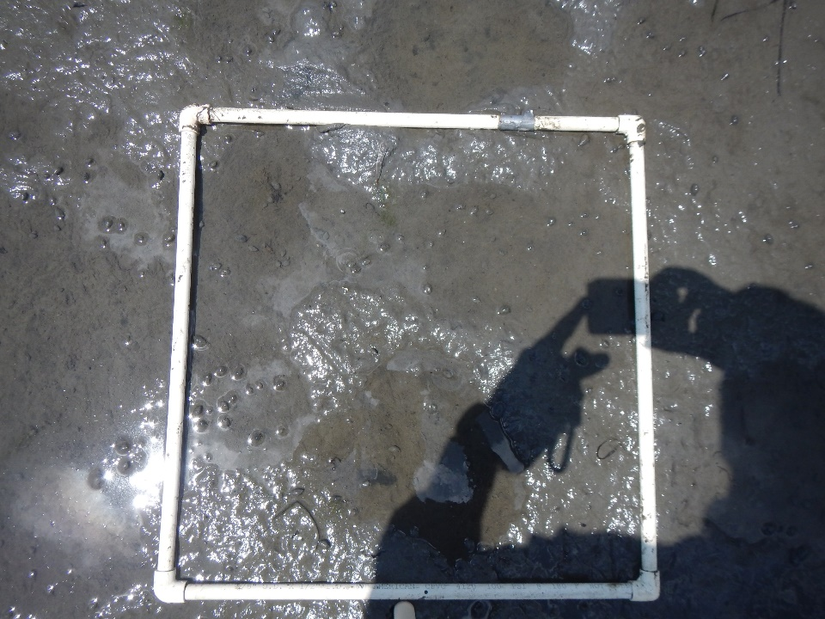
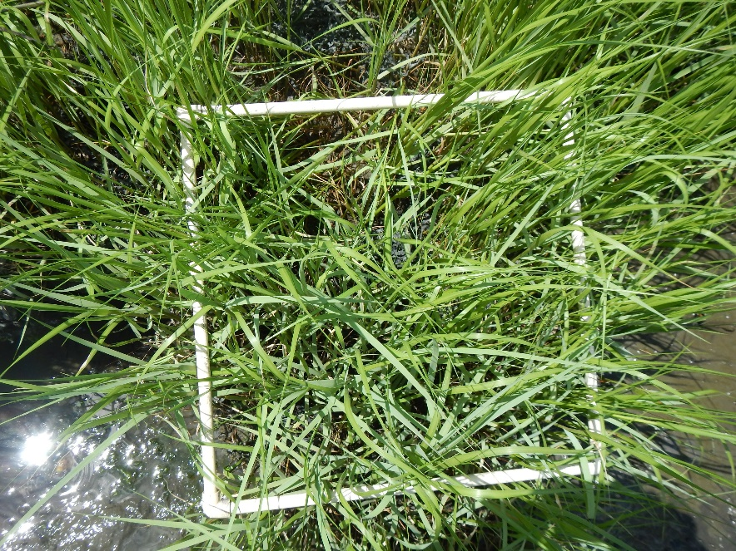
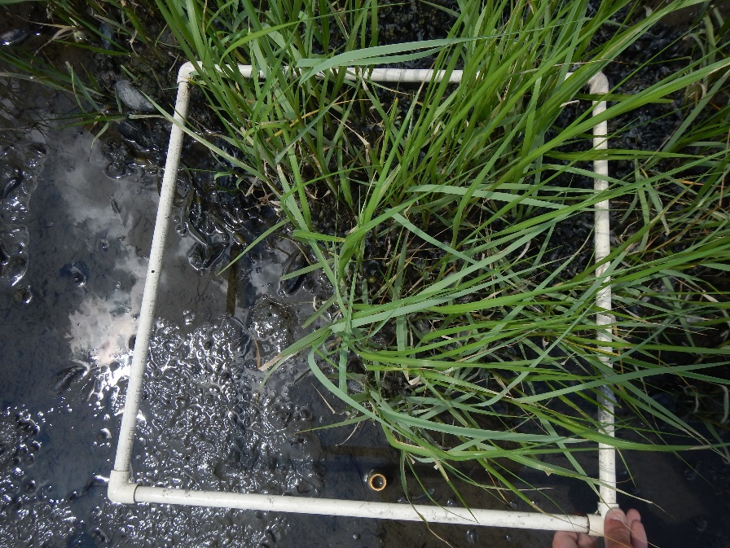
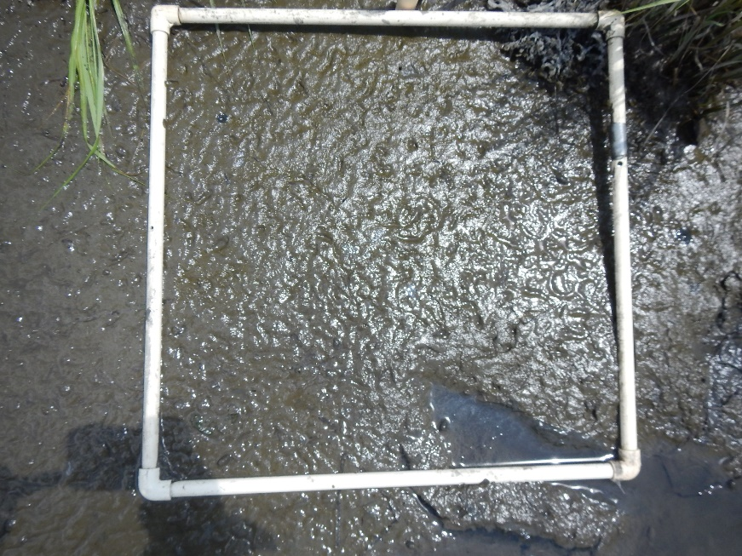
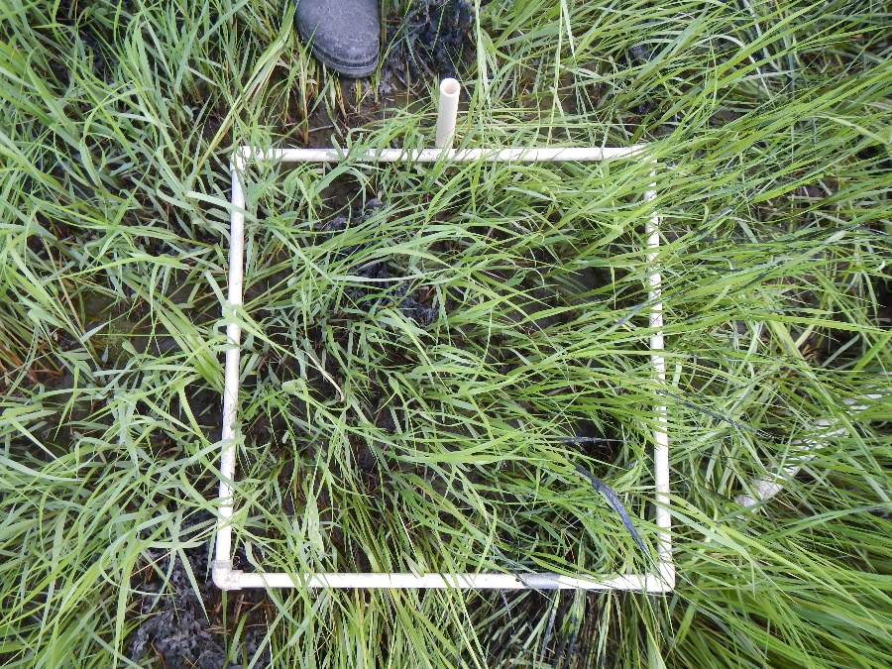
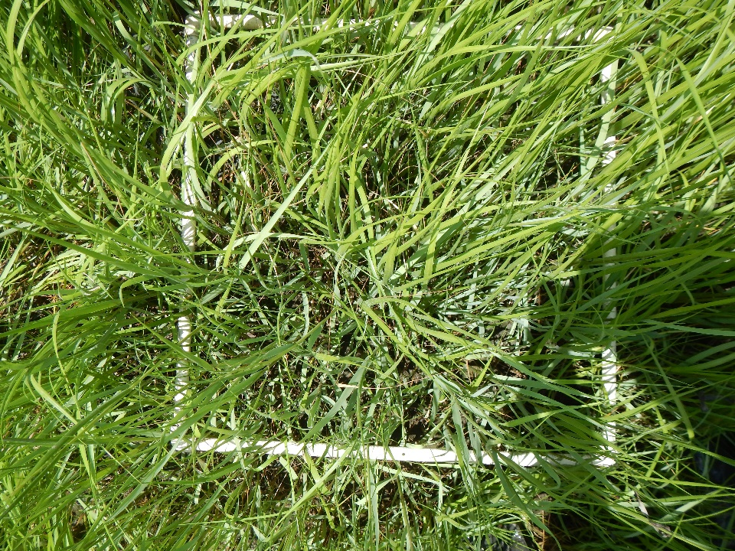
A
Site:
LC
B
Date:
6/26/20
C
A-0.5
B-0.5
C-0.5
0.5
A-1.0
B-1.0
C-1.0
1.0
A-1.5
B-1.5
C-1.5
1.5

Slide 8
A
Site:
DR
B
Date:
6/26/20
C
A-0.5
B-0.5
C-0.5
0.5
A-1.0
B-1.0
C-1.0
1.0
A-1.5
B-1.5
C-1.5
1.5

Slide 9
August 2020

Slide 10
A
Site: 4TI
Cover
B
Date:
C
A-0.0
B-0.0 missing
C-0.0 missing
0.0
A-0.5 missing
B-0.5
C-0.5
0.5
A-1.0 missing
B-1.0
C-1.0 missing
1.0

Slide 11
A
Site: 4TI
Cover
B
Date:
8/20/20
C
A-1.5
B-1.5
C-1.5 missing
1.5
A-2.0
B-2.0
C-2.0
2.0
A-2.5
B-2..5 missing
C-2.5
2.5

Slide 12
A
Site: 4TI
Biomass
B
Date:
8/20/20
C
A-0.0 missing
B-0.0 missing
C-0.0 missing
0.0
A-0.5 missing
B-0.5
C-0.5
0.5
A-1.0 missing
B-1.0
C-1.0 missing
1.0

Slide 13
A
Site: 4TI
B
Date:
8/20/20
C
A-1.5
B-1.5
C-1.5 missing
1.5
A-2.0
B-2.0
C-2.0
2.0
A-2.5
B-2..5 missing
C-2.5
2.5

Slide 14
A
Site: CP
Cover
B
Date:
8/19/20
C
A-0.0
B-0.0
C-0.0
0.0
A-0.5
B-0.5
C-0.5
0.5
A-1.0 missing
B-1.0
C-1.0
1.0
A-1.5
B-1.5
C-1.5
1.5

Slide 15
A
Site: CP
Biomass
B
Date:
8/19/20
C
A-0.0
B-0.0
C-0.0
0.0
A-0.5
B-0.5 missing
C-0.5
0.5
A-1.0 missing
B-1.0
C-1.0
1.0
A-1.5
B-1.5
C-1.5
1.5

Slide 16
A
Site: AP cover
B
Date:
8/24/20
C
A-1
B-1
C-1
0.0
A-2
B-2
C-2
0.5
A-3
B-3
C-3
1.0
A-4
B-4
C-4
1.5

Slide 17
A
Site: AP Biomass
B
Date:
8/24/20
C
A-1
B-1
C-1
0.0
A-2
B-2
C-2
0.5
A-3
B-3
C-3
1.0
A-4
B-4
C-4
1.5

Slide 18
A
Site:
LC Cover
B
Date:
8/26/20
C
A-0.5
B-0.5
C-0.5
0.5
A-1.0
B-1.0
C-1.0
1.0
A-1.5
B-1.5
C-1.5
1.5

Slide 19
A
Site:
LC Biomass
B
Date:
8/26/20
C
A-0.5
B-0.5
C-0.5
0.5
A-1.0
B-1.0
C-1.0
1.0
A-1.5
B-1.5
C-1.5
1.5

Slide 20
A
Site:
DR Cover
B
Date:
8/27/20
C
A-0.5
B-0.5
C-0.5
0.5
A-1.0
B-1.0
C-1.0
1.0
A-1.5
B-1.5
C-1.5
1.5

Slide 21
A
Site:
DR Biomass
B
Date:
8/26/20
C
A-0.5
B-0.5
C-0.5
0.5
A-1.0
B-1.0
C-1.0
1.0
A-1.5
B-1.5
C-1.5
1.5

Slide 22
October 2020

Slide 23
A
Site: 4TI
B
Date:
10/20/20
C
A-0.0
B-0.0
C-0.0
0.0
A-0.5
B-0.5
C-0.5
0.5
A-1.0
B-1.0
C-1.0
1.0

Slide 24
A
Site: 4TI
B
Date:
_10/20/20__
C
A-1.5
B-1.5
C-1.5
1.5
A-2.0
B-2.0
C-2.0 No Photo
2.0
A-2.5
B-2..5
C-2.5
2.5

Slide 25
A
Site: CP
B
Date:
10/19/20
C
A-0.0
B-0.0
C-0.0
0.0
A-0.5
B-0.5
C-0.5
0.5
A-1.0
B-1.0
C-1.0
1.0
A-1.5
B-1.5
C-1.5
1.5

Slide 26
A
Site: AP
B
Date:
10/19 and 10/20/20
C
A-1
B-1
C-1
0.0
A-2
B-2
C-2
0.5
A-3
B-3
C-3
1.0
A-4
B-4
C-4
1.5

Slide 27
A
Site:
LC
B
Date:
10/22/20
C
A-0.5
B-0.5
C-0.5
0.5
A-1.0
B-1.0
C-1.0
1.0
A-1.5
B-1.5
C-1.5
1.5

Slide 28
A
Site:
DR
B
Date:
10/22/20
C
A-0.5
B-0.5
C-0.5
0.5
A-1.0
B-1.0
C-1.0
1.0
A-1.5
B-1.5
C-1.5
1.5

