Slide 1
2019 Intertidal Seaweed Photos Table of Contents
June 2019 Cover
Four Tree Island………..………………………….. Slide 3-4
Adams Point…………………………………………. Slide 5
Depot Road………………………………………….. Slide 6
Hilton Park……………………………………………. Slide 7-8
Sunset Hill Farm……………………………………. Slide 9
August 2019 Cover + Biomass
Adams Point Cover……………………………….. Slide 11
Adams Point Biomass……………………………. Slide 12
Depot Road Cover…………………………………. Slide 13
Depot Road Biomass……………………………… Slide 14
Hilton Park Cover…………………………………… Slide 15-16
Hilton Park Biomass……………………………….. Slide 17-18
Four Tree Island Cover……………………………. Slide 19-20
Four Tree Island Biomass……………………….. Slide 21-22
Sunset Hill Farm Cover…………………………… Slide 23
Sunset Hill Farm Biomass……………………….. Slide 24
October 2019 Cover
Adams Point…………………………………………… Slide 26
Depot Road……………………………………………. Slide 27
Four Tree Island……………………………………… Slide 28-29
Sunset Hill Farm……………………………………… Slide 30
Hilton Park……………………………………………… Slide 31-32

Slide 2
June 2019

Slide 3
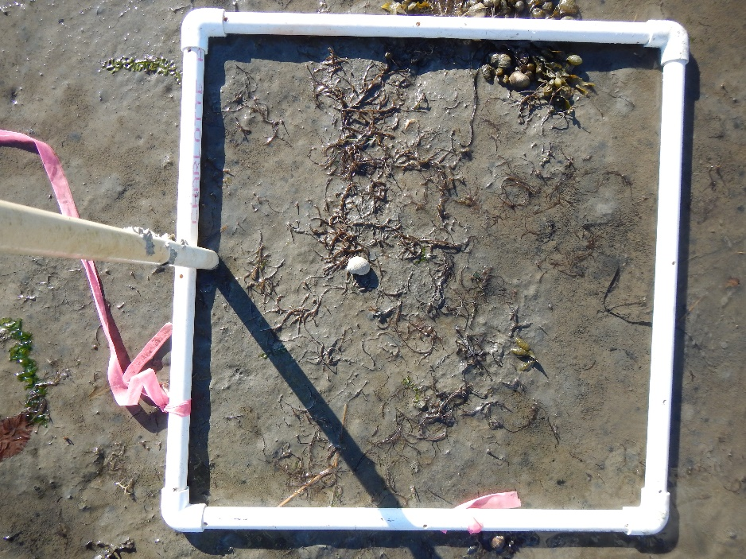
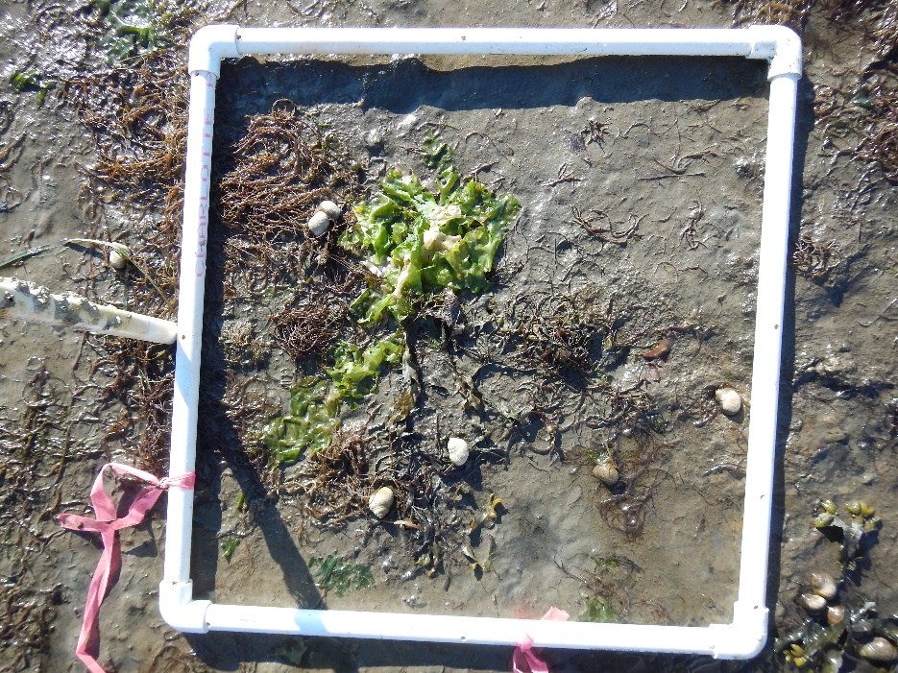
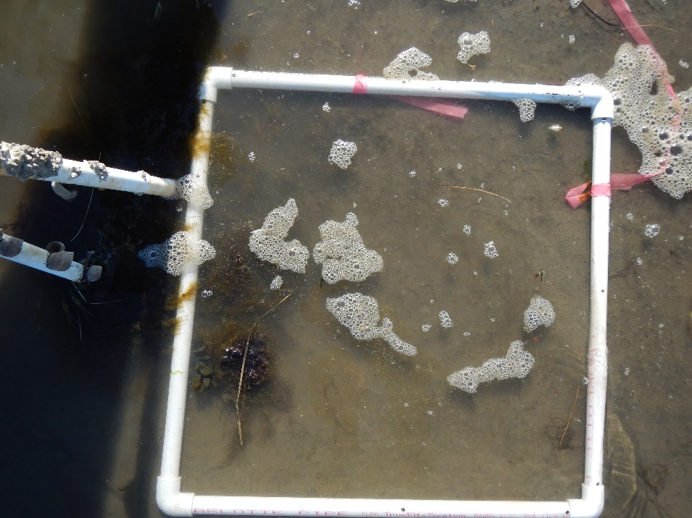
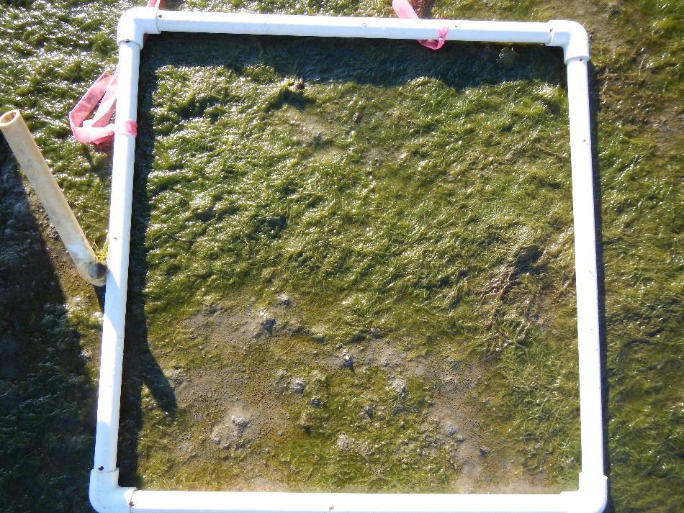
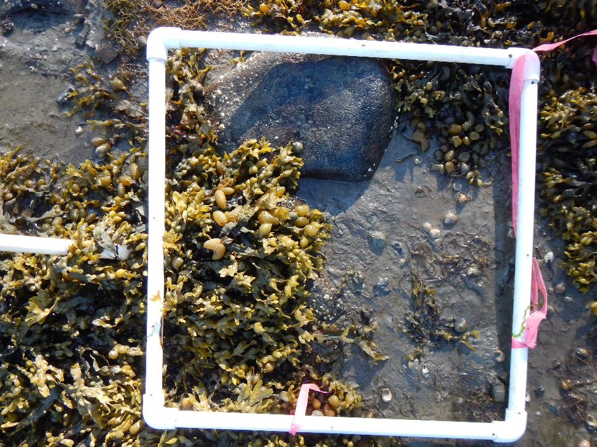
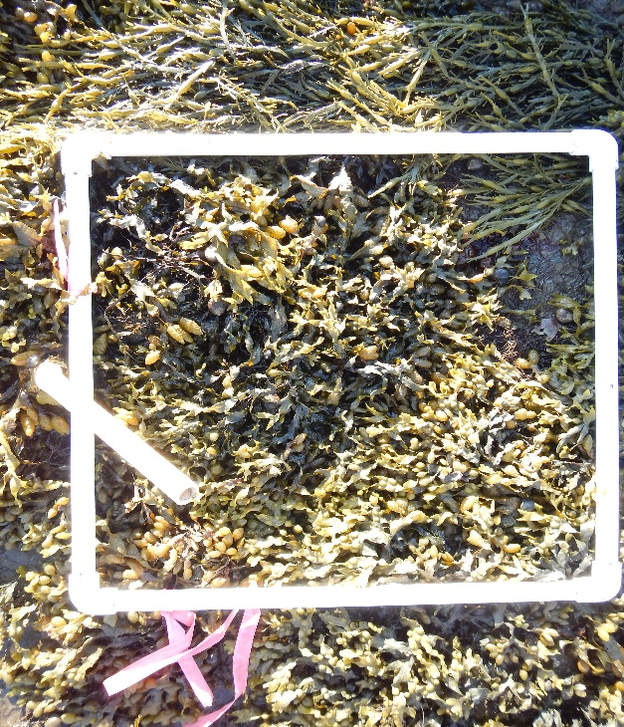
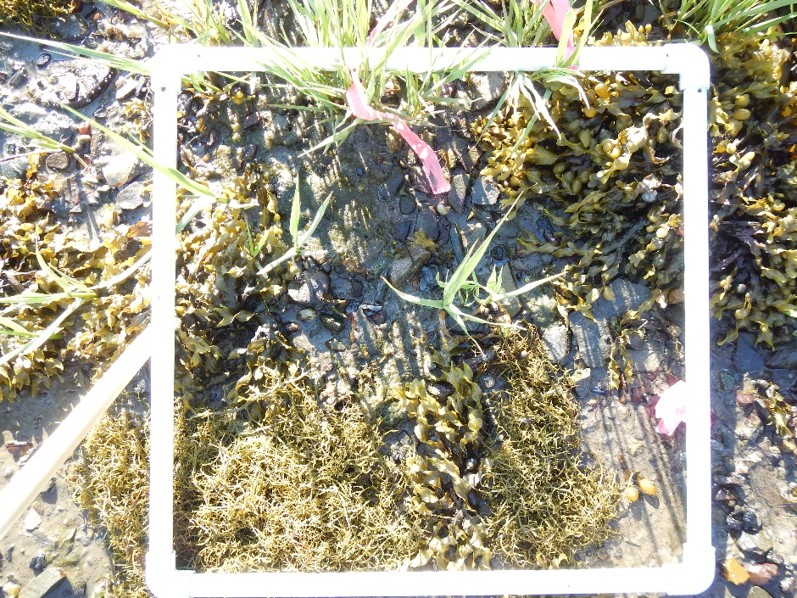
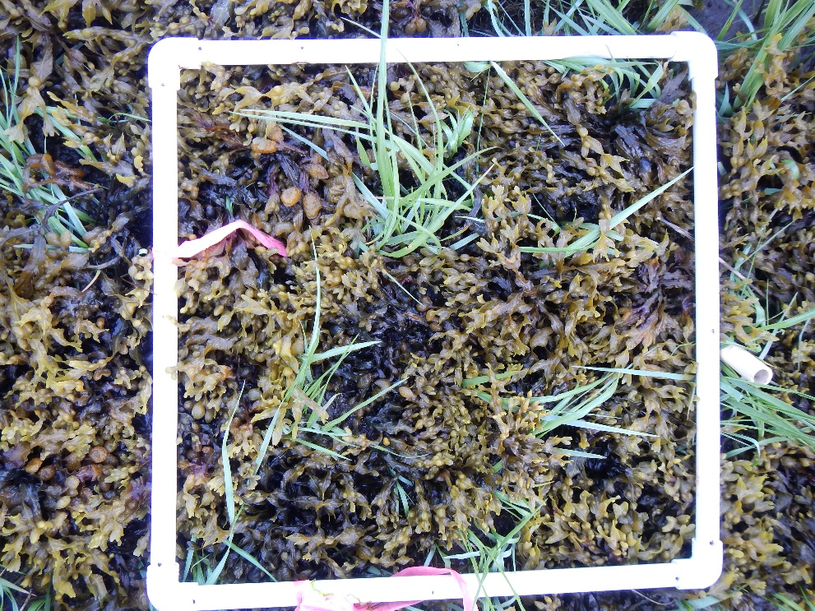
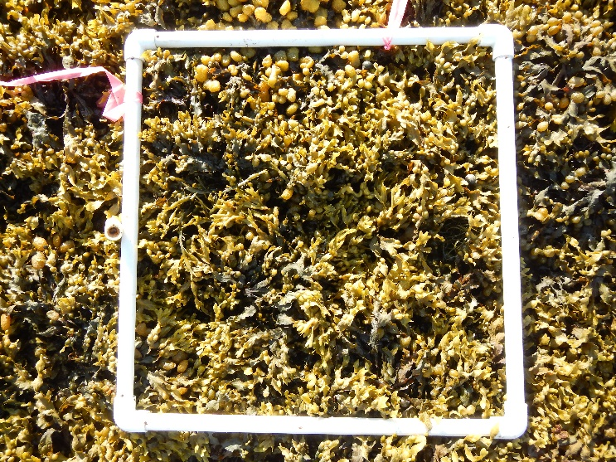
A
Site: Four Tree Island
B
Date:
6/17/2019
C
A-0.0
B-0.0
C-0.0
0.0
A-0.5
B-0.5
C-0.5
0.5
A-1.0
B-1.0
C-1.0
1.0

Slide 4
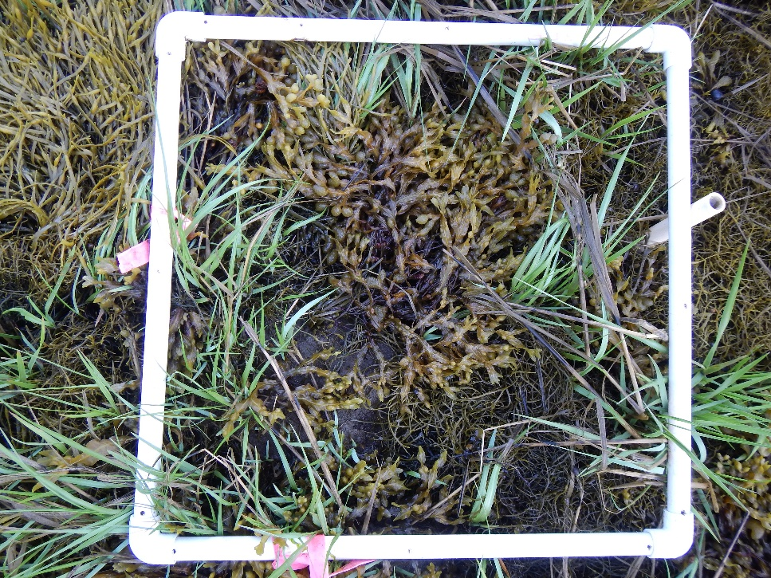
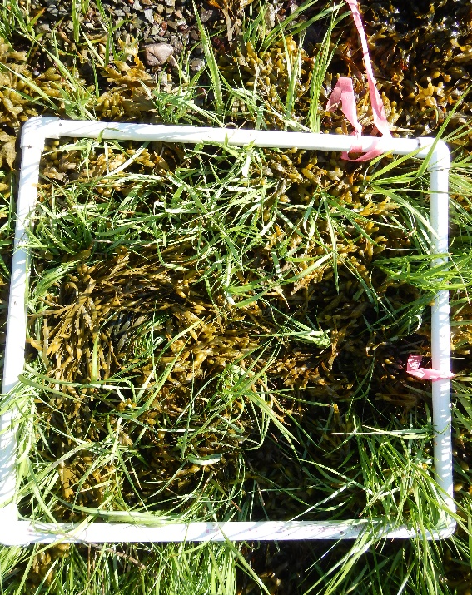
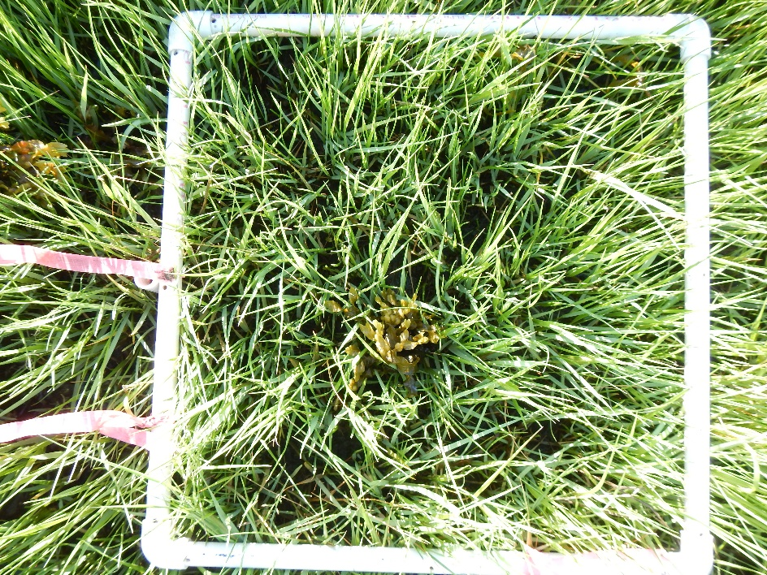
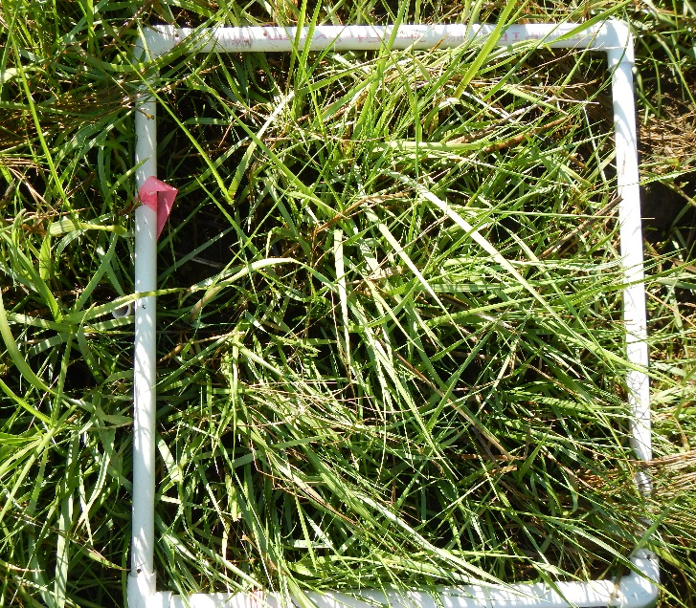
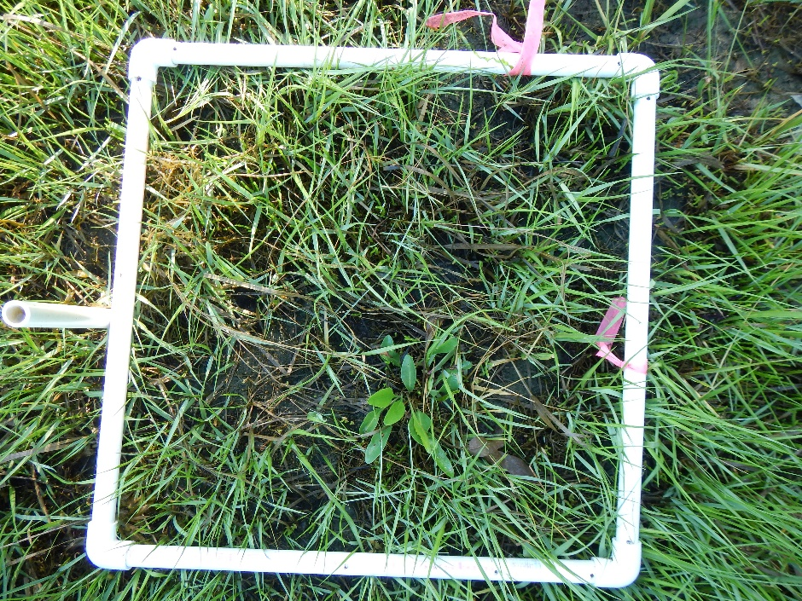
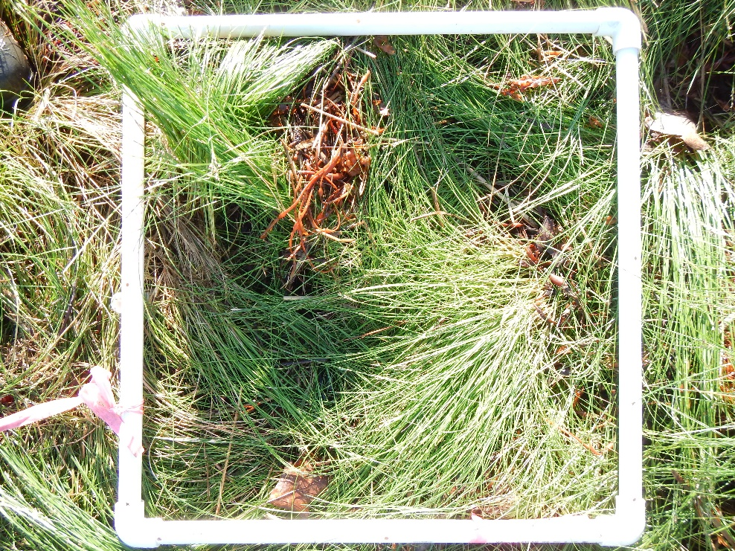
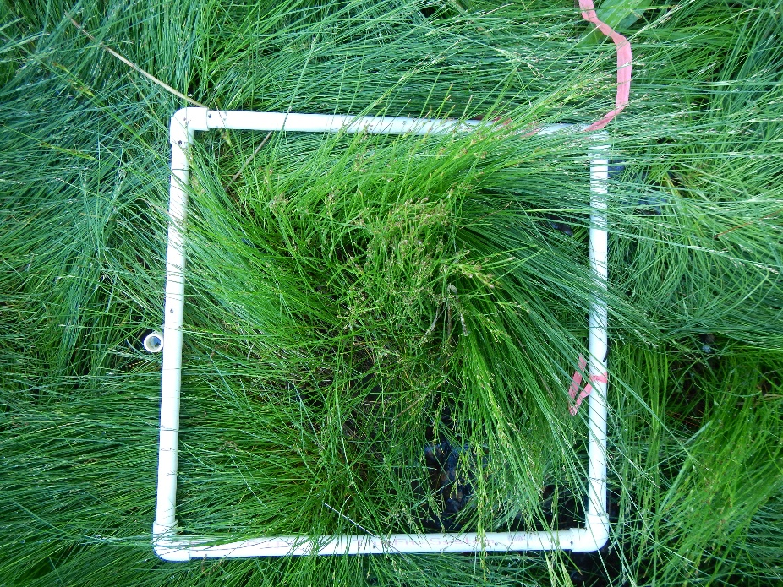
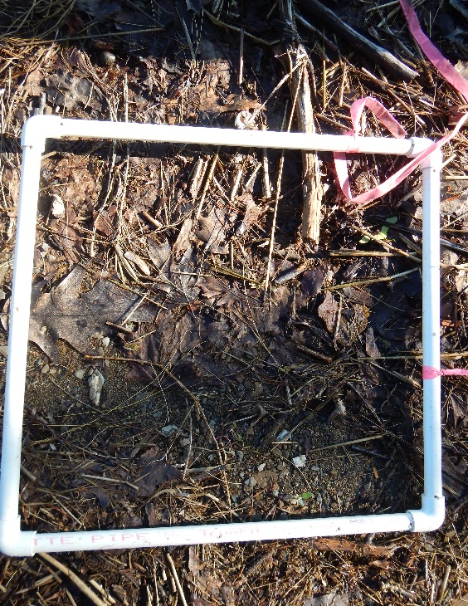
A
Site: 4TI
B
Date:
6/17/2019
C
A-1.5
B-1.5
C-1.5
1.5
A-2.0
B-2.0
C-2.0
2.0
A-2.5
B-2..5
C-2.5
2.5

Slide 5
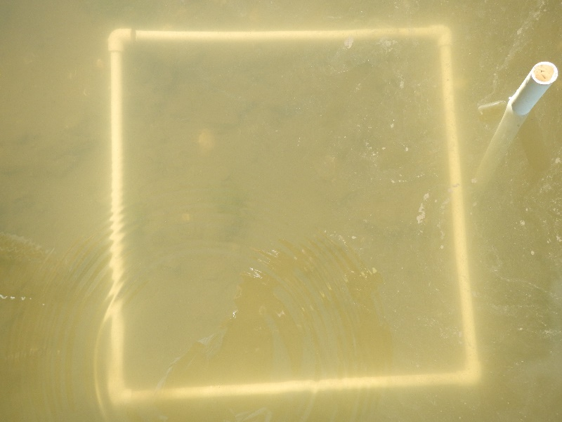
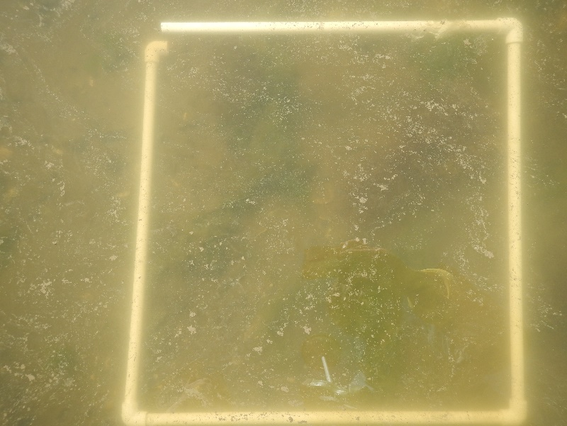
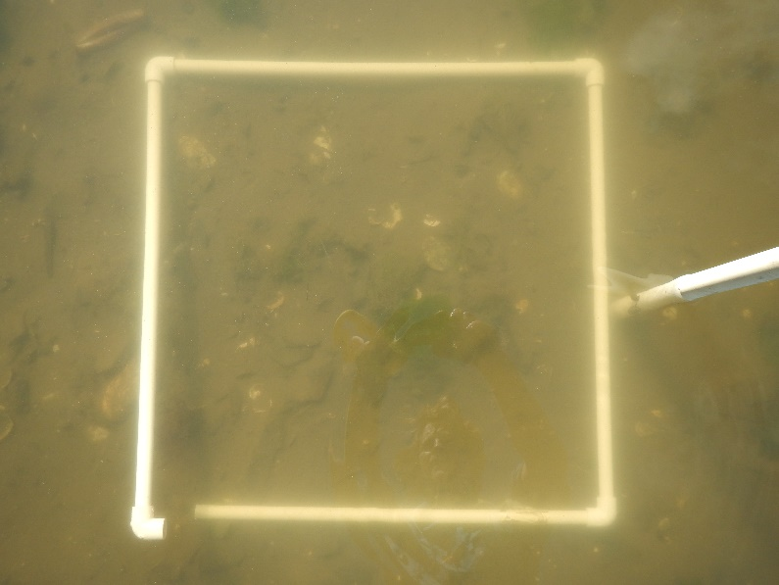
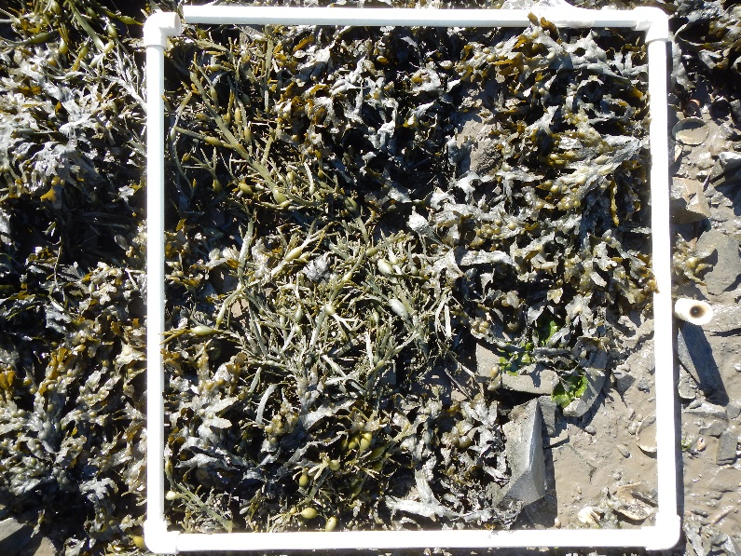
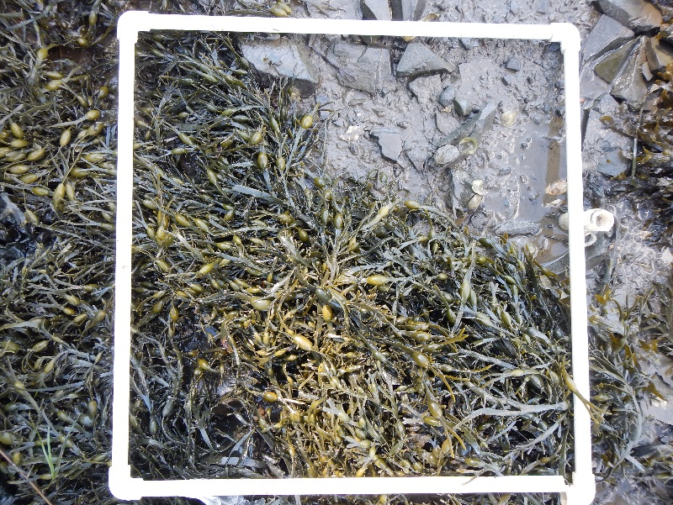
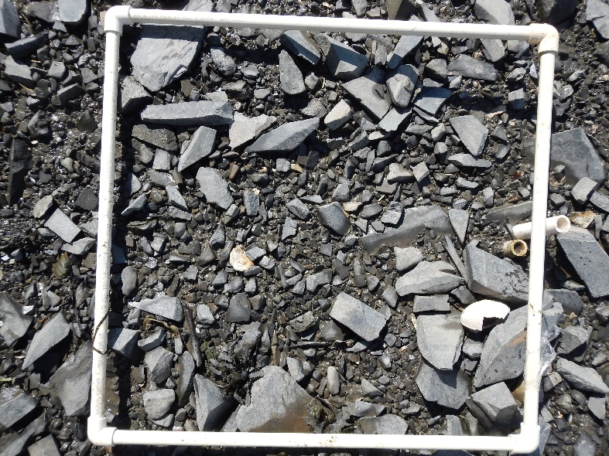
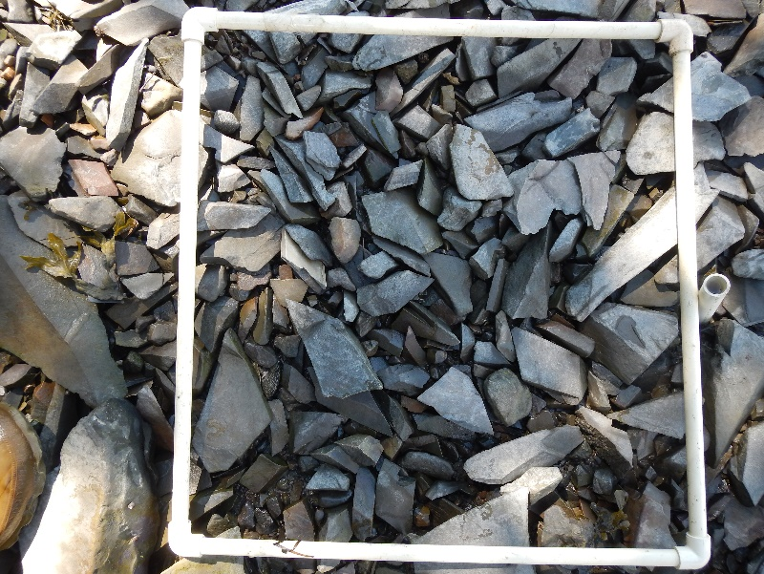
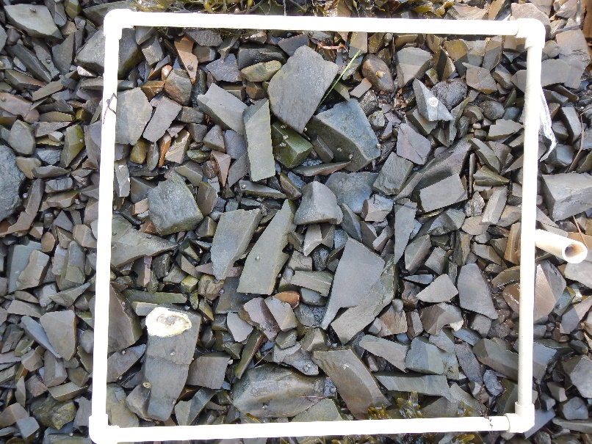
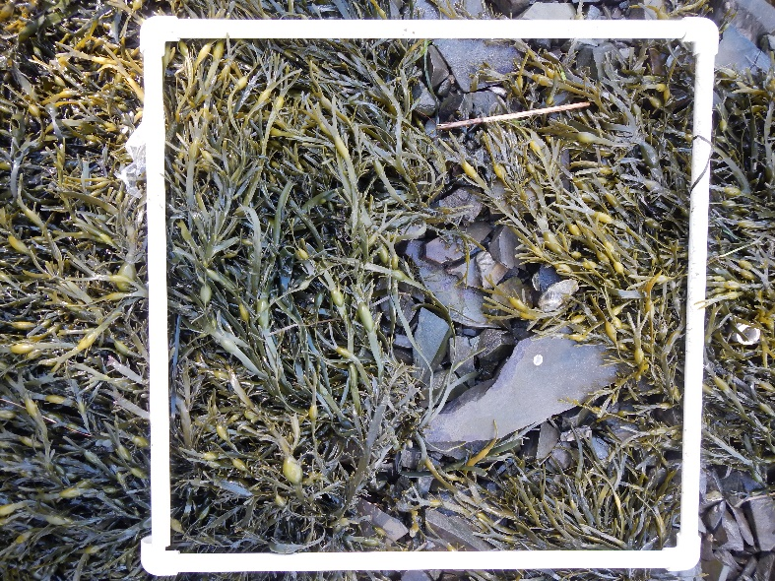
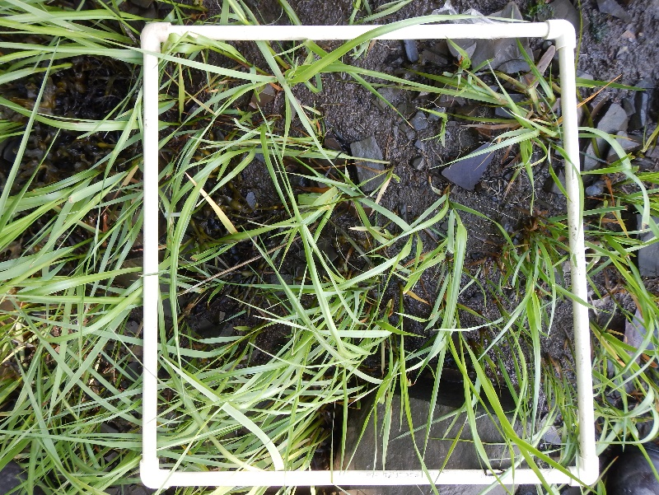
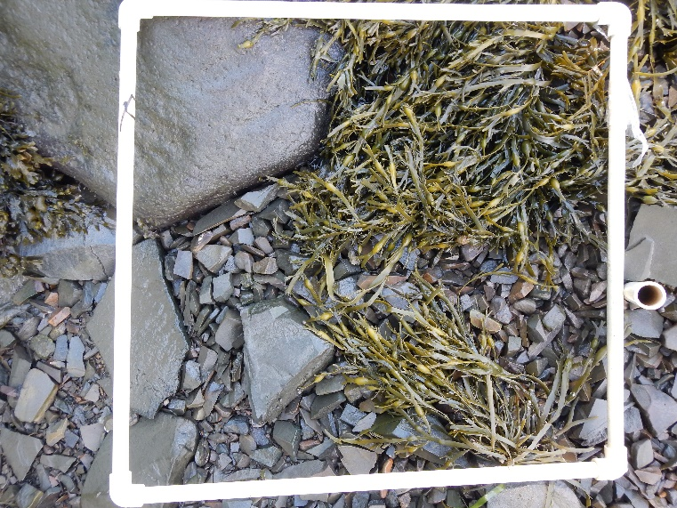
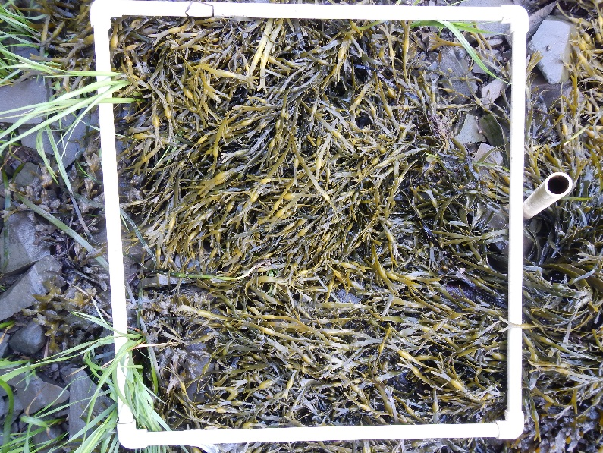
A
B-1
C-1
A-1
B
Date:
17June2019
C
Site: AP
Adams Pt
0.0
A-2
B-2
C-2
0.5
A-3
B-3
C-3
1.0
A-4
B-4
C-4
1.5

Slide 6
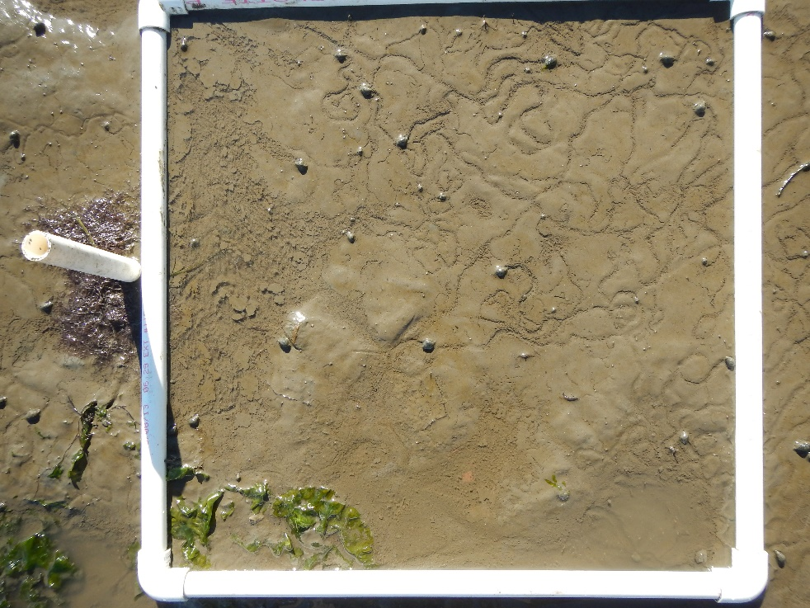
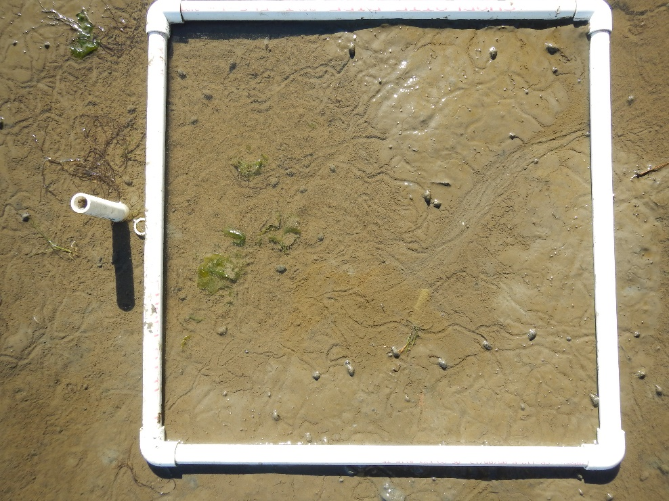
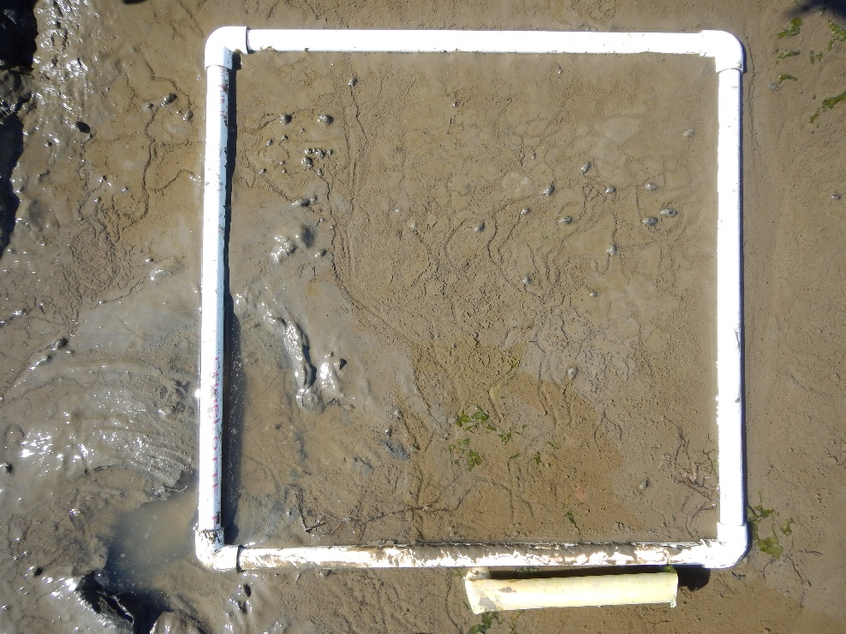
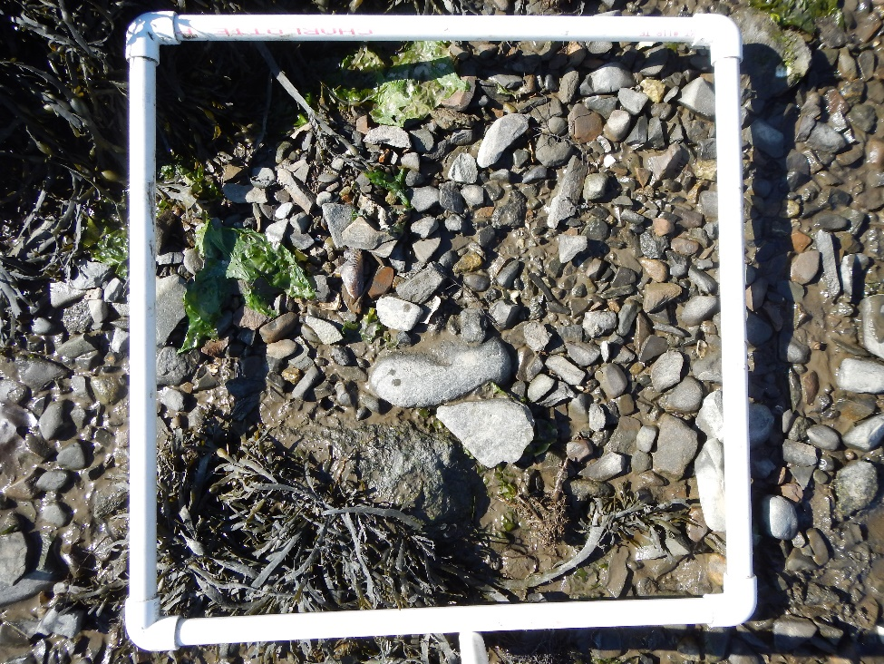
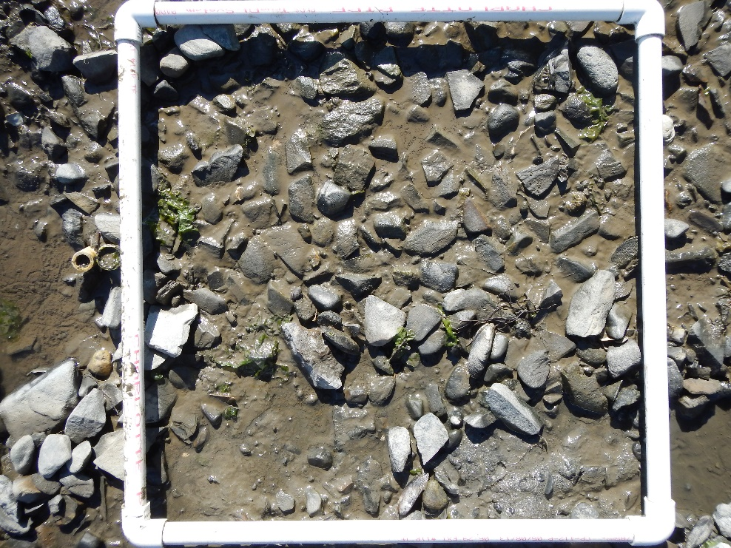
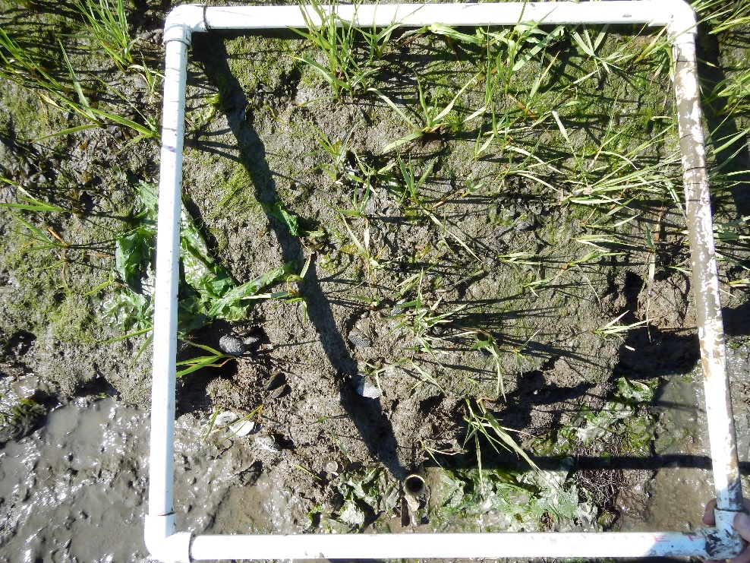
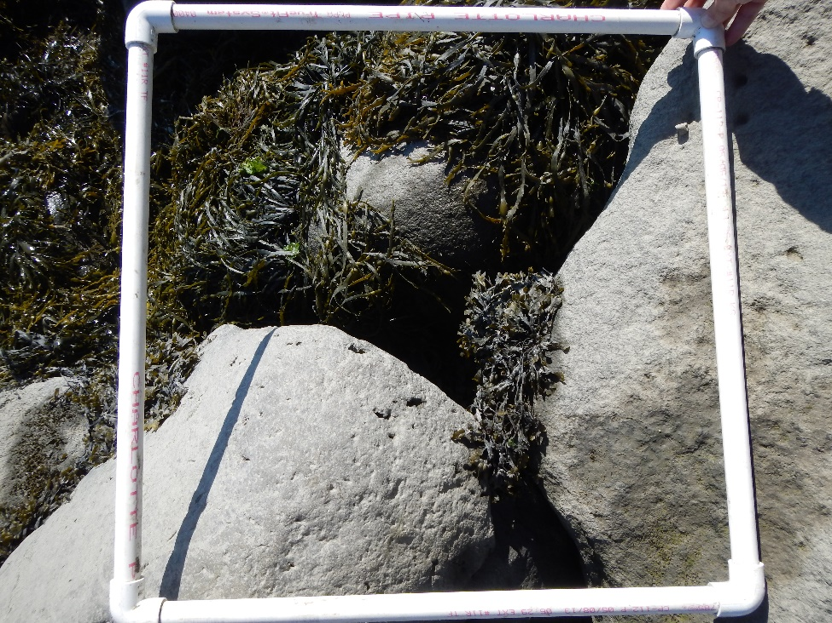
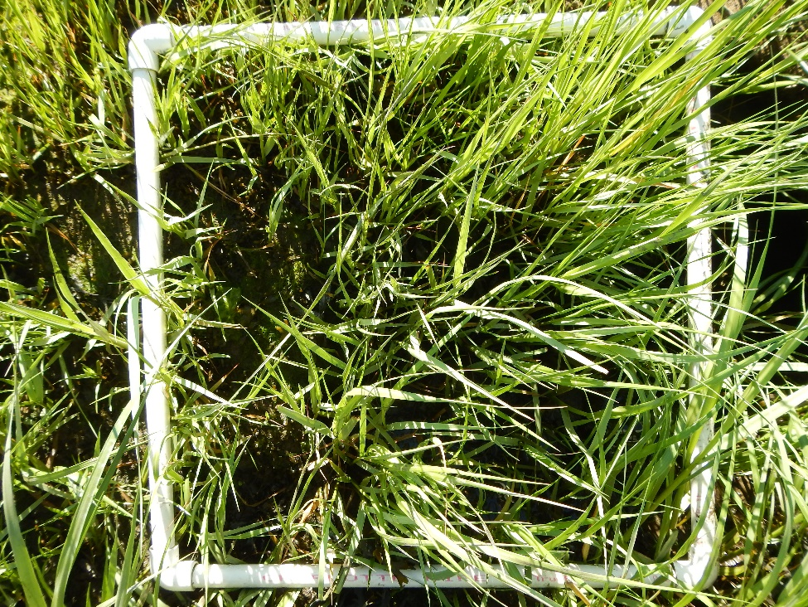
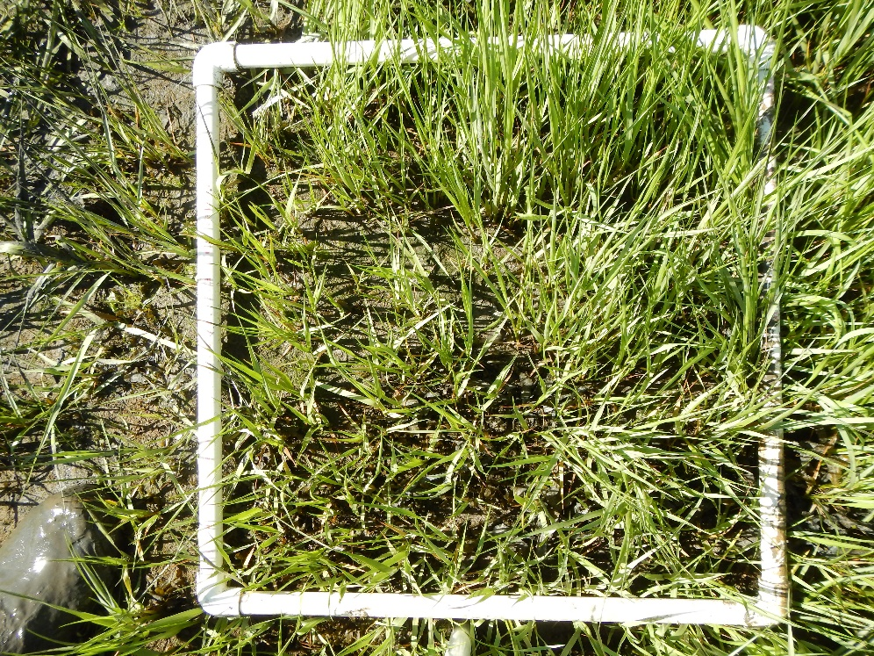
A
B
C
Site:
Depot Road
A-1
B-1
Date:
6/17/19
C-1
0.5
1.0
1.5
A-2
B-2
C-2
A-3
B-3
C-3

Slide 7
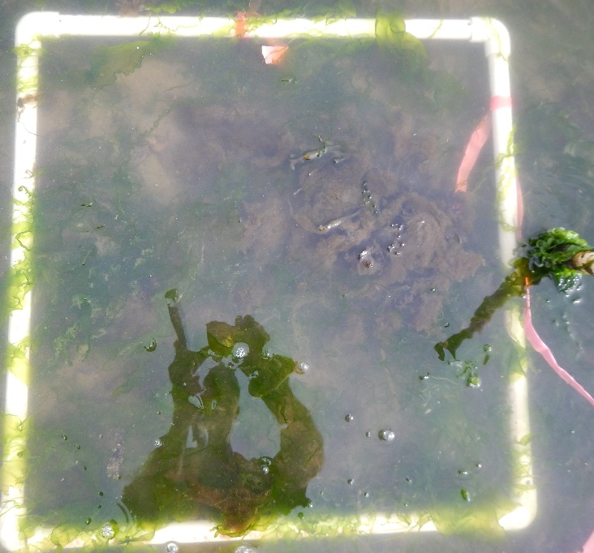
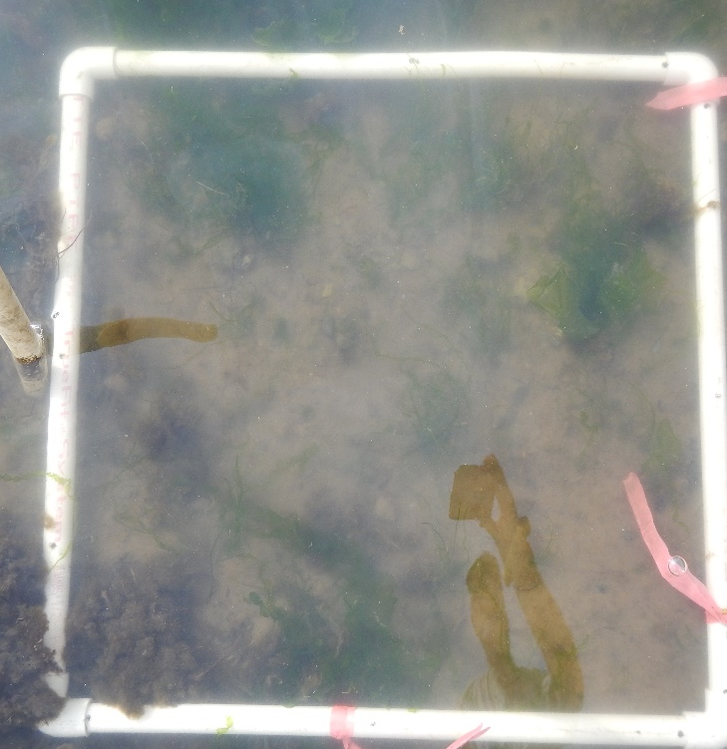
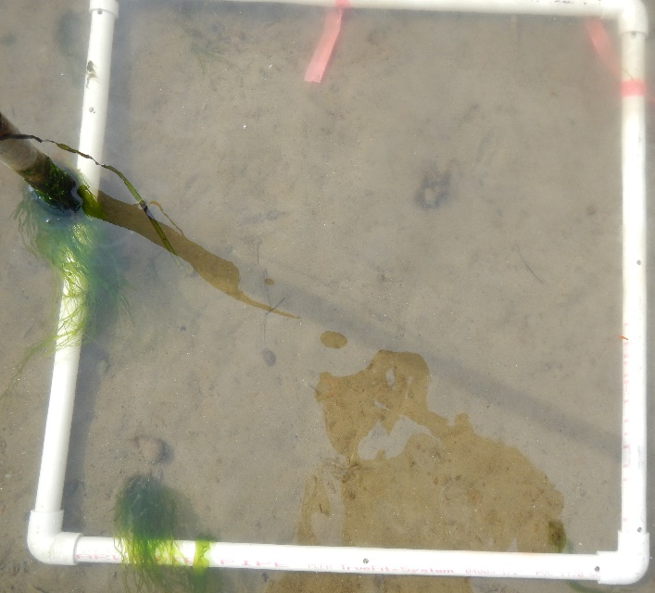
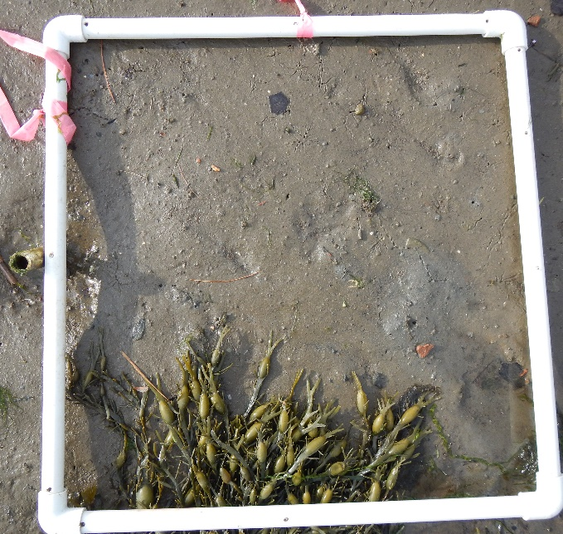
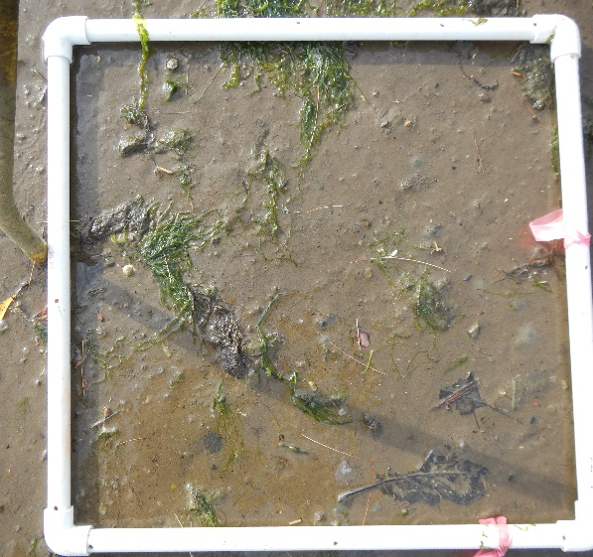
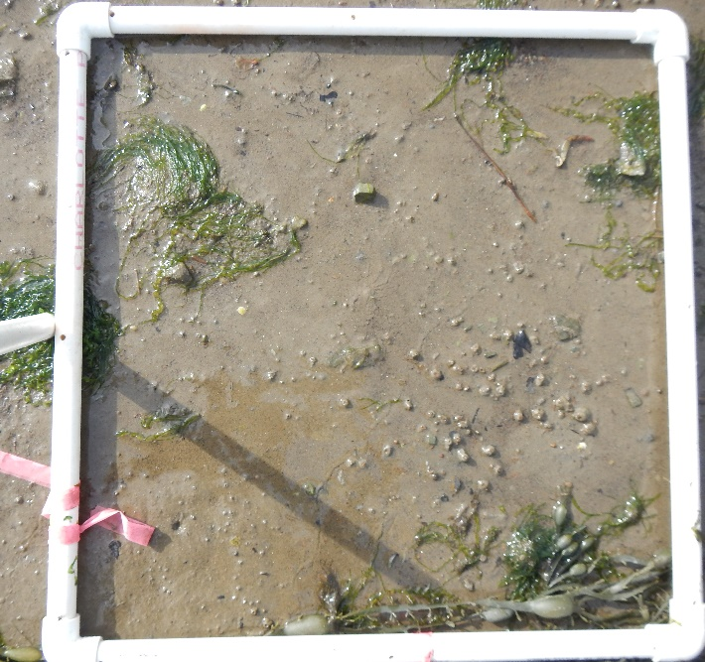
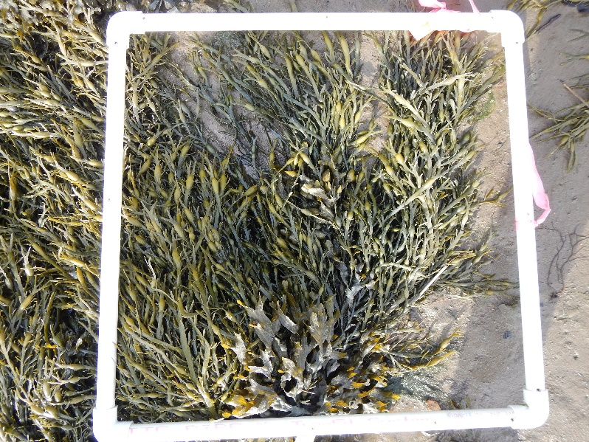
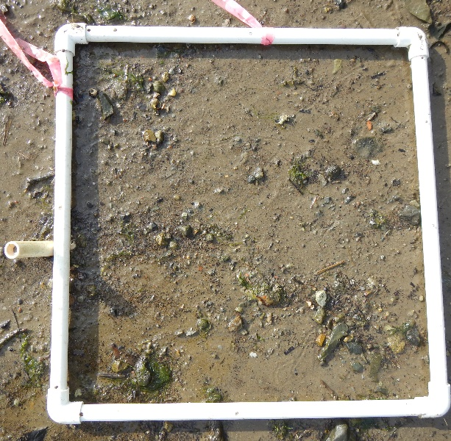
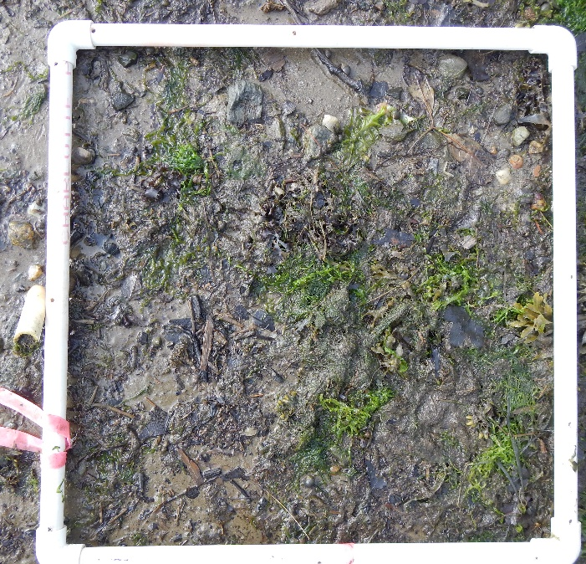
A B C
Date:
6/18/19
A-1
Site:
Hilton Park
B-1
C-1
0.0
0.5
1.0
A-2
B-2
C-2
A-3
B-3
C-3

Slide 8
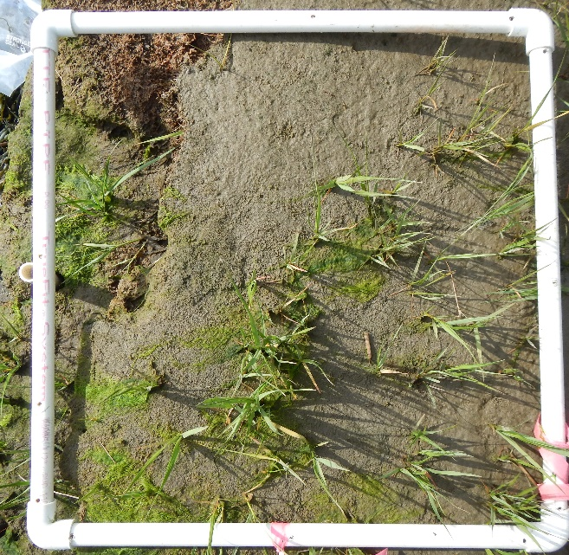
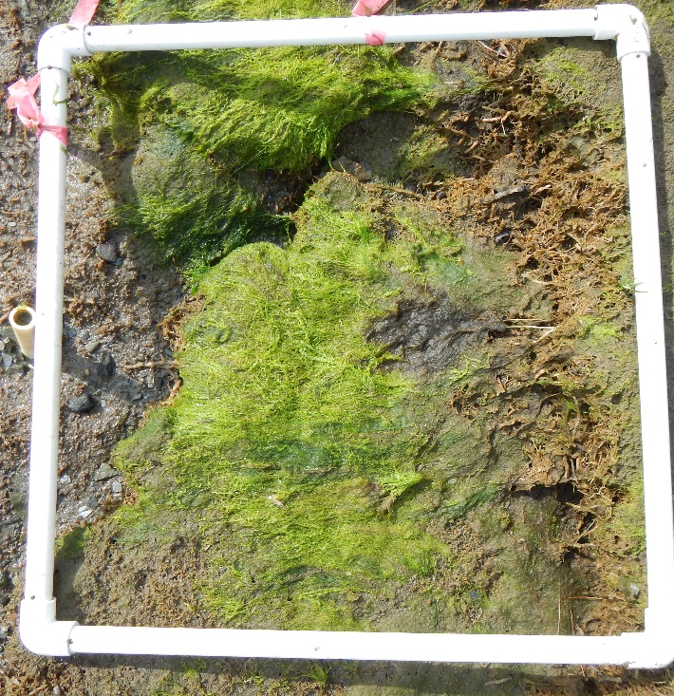
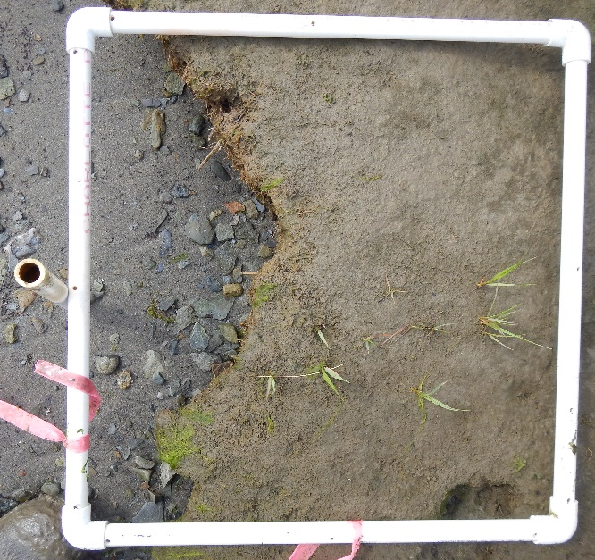
A B C
Site: HP
Date:
6/18/19
1.5
2.0
A-4
B-4
C-4
A-5
B-5
C-5

Slide 9
A B C
Site:
Sunset Hill Farm
Date:
6/19/19
A-0.5
B-0.5
C-0.5
0.75
1.0
1.5
A-1.0
B-1.0
C-1.0
A-1.5
B-1.5
C-1.5

Slide 10
August 2019

Slide 11
A
B-1
C-1
A-1
Site: AP
Adams Pt
Cover (0.25m2 quadrat)
B
Date:
8/1/19
C
0.0
A-2
B-2
C-2
0.5
A-3
B-3
C-3
1.0
A-4
B-4
C-4
1.5

Slide 12
A
B-1
photo missing
(too muddy)
C-1
photo missing
(too muddy)
A-1
photo missing
(too muddy)
Site: AP
Adams Pt
Biomass (0.0625m² quadrat)
B
Date:
8/1/19
C
0.0
A-2
B-2
C-2
0.5
A-3
B-3
C-3
1.0
A-4
B-4
C-4
1.5

Slide 13
A
B
C
A-1
Site: Depot Rd
COVER (0.25m2 quadrats
B-1
Date: 8/1/19
C-1
0.5
1.0
1.5
A-2
B-2
C-2
A-3
B-3
C-3

Slide 14
A
B
C
A-1
Site:
Depot Rd
BIOMASS
(0.0625m2)
B-1
C-1
Date:
8/1/19
0.5
1.0
1.5
A-2
B-2
C-2
A-3
B-3
C-3

Slide 15
A B C
A-1
B-1
Date:
___8/5/19______
C-1
Site:
Hilton Park
Cover
(0.25m2 quadrat)
0.0
0.5
1.0
A-2
B-2
C-2
A-3
B-3
C-3

Slide 16
A B C
1.5
2.0
A-4
B-4
C-4
Site: HP
Cover
Date: 8/5/19
_________
A-5
B-5
C-5

Slide 17
A B C
A-1
B-1
C-1
Site: HP
Biomass
(0.0625 m2 quadrat)
0.0
0.5
1.0
Date: 8/5/19
A-2
B-2
C-2
A-3
B-3
C-3

Slide 18
A B C
1.5
2.0
A-4
B-4
C-4
Site: HP
Biomass (0.0625m2)
Date: 8/5/19
A-5
B-5
C-5

Slide 19
A B C
Site: Four Tree Island
Cover (0.25m2 quadrat)
A-0.0
B-0.0
C-0.0
Date: 8/6/19
0.0
0.5
1.0
A-0.5
B-0.5
C-0.5
A-1.0
B-1.0
C-1.0

Slide 20
A B C
A-1.5
B-1.5
C-1.5
1.5
2.0
2.5
Site: 4TI
Cover (0.25m2 quad)
Date: 8/6/19
A-2.0
B-2.0
C-2.0
A-2.5
B-2..5
C-2.5

Slide 21
A B C
Date: 8/6/19
_________
A-0.0
Site: Four Tree Island
Biomass (.0625m2 quadrat
C-0.0
B-0.0
0.0
0.5
1.0
A-0.5
B-0.5
C-0.5
A-1.0
B-1.0
C-1.0

Slide 22
A B C
Site: 4TI
Biomass (0.0625m2)
Date: 8/6/19
_________
A-1.5
B-1.5
C-1.5
1.5
2.0
2.5
A-2.0
B-2.0
C-2.0
A-2.5
B-2..5
C-2.5

Slide 23
A B C
Site:
Sunset Hill Farm
COVER
(0.25m² quadrat)
Date:
8/9/19
A-0.5
B-0.5
C-0.5
0.75
1.0
1.5
A-1.0
B-1.0
C-1.0
A-1.5
B-1.5
C-1.5

Slide 24
A B C
A-0.5
B-0.5
C-0.5
0.75
1.0
1.5
Site:
SHF
BIOMASS
(0.0625m2)
Date:
8/9/19
A-1.0
B-1.0
C-1.0
A-1.5
B-1.5
C-1.5

Slide 25
October 2019

Slide 26
A
C-1
A-1
B-1
C
Site: Adams Point
B
Date:
9/30/19
0.0
A-2
B-2
C-2
0.5
A-3
B-3
C-3
1.0
A-4
B-4
C-4
1.5

Slide 27
A
B
C
A-0.5
B-0.5
C-0.5
Site:
Depot Rd
Date:
9/30/19
0.5
1.0
1.5
A-1.0
B-1.0
C-1.0
A-1.5
B-1.5
C-1.5

Slide 28
A B C
A-0.0
B-0.0
C-0.0
Site: Four Tree Island
Date:
10/1/19
0.0
0.5
1.0
A-0.5
B-0.5
C-0.5
A-1.0
B-1.0
C-1.0

Slide 29
A B C
A-1.5
Site: 4TI
B-1.5
C-1.5
1.5
2.0
2.5
Date:
10/1/19
A-2.0
B-2.0
C-2.0
A-2.5
B-2..5
C-2.5

Slide 30
A B C
A-0.5
B-0.5
C-0.5
Site:
Sunset Hill Farm
Date:
10/2/19
0.75
1.0
1.5
A-1.0
B-1.0
C-1.0
A-1.5
B-1.5
C-1.5

Slide 31
A B C
A-1
B-1
Date:
10/4/19
C-1
Site:
Hilton Park
0.0
0.5
1.0
A-2
B-2
C-2
A-3
B-3
C-3

Slide 32
A B C
1.5
2.0
A-4
B-4
C-4
Site: HP
Date: 10/4/19
A-5
B-5
C-5

