Slide 1
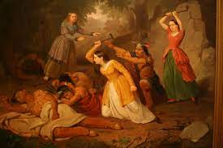
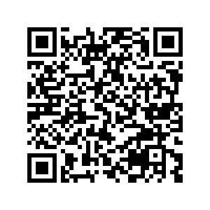
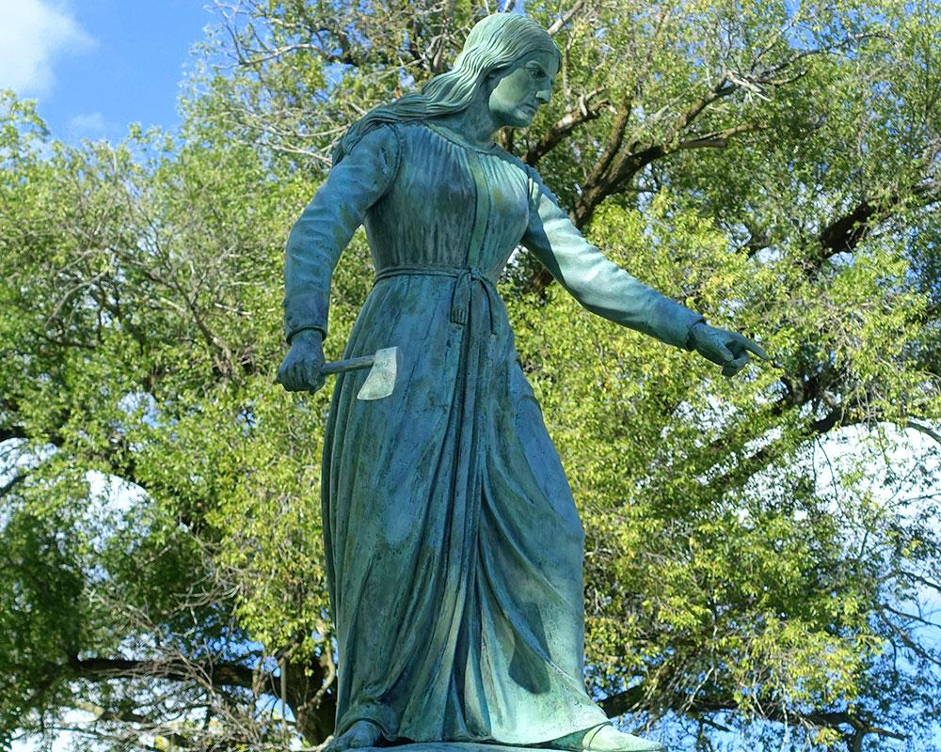
Hannah Duston Timeline By:Amanda Higham
The controversy over whether Hannah Dunston is a hero or villain is widely debated, but here is an objective account of the timeline of events that occurred…
Work Cited
Weis, A.-M. (1998). The Murderous Mother and the Solicitous Father: Violence, Jacksonian Family Values, and Hannah Duston’s Captivity. American Studies International, 36(1), 46–65. http://www.jstor.org/stable/41279557

