Slide 1
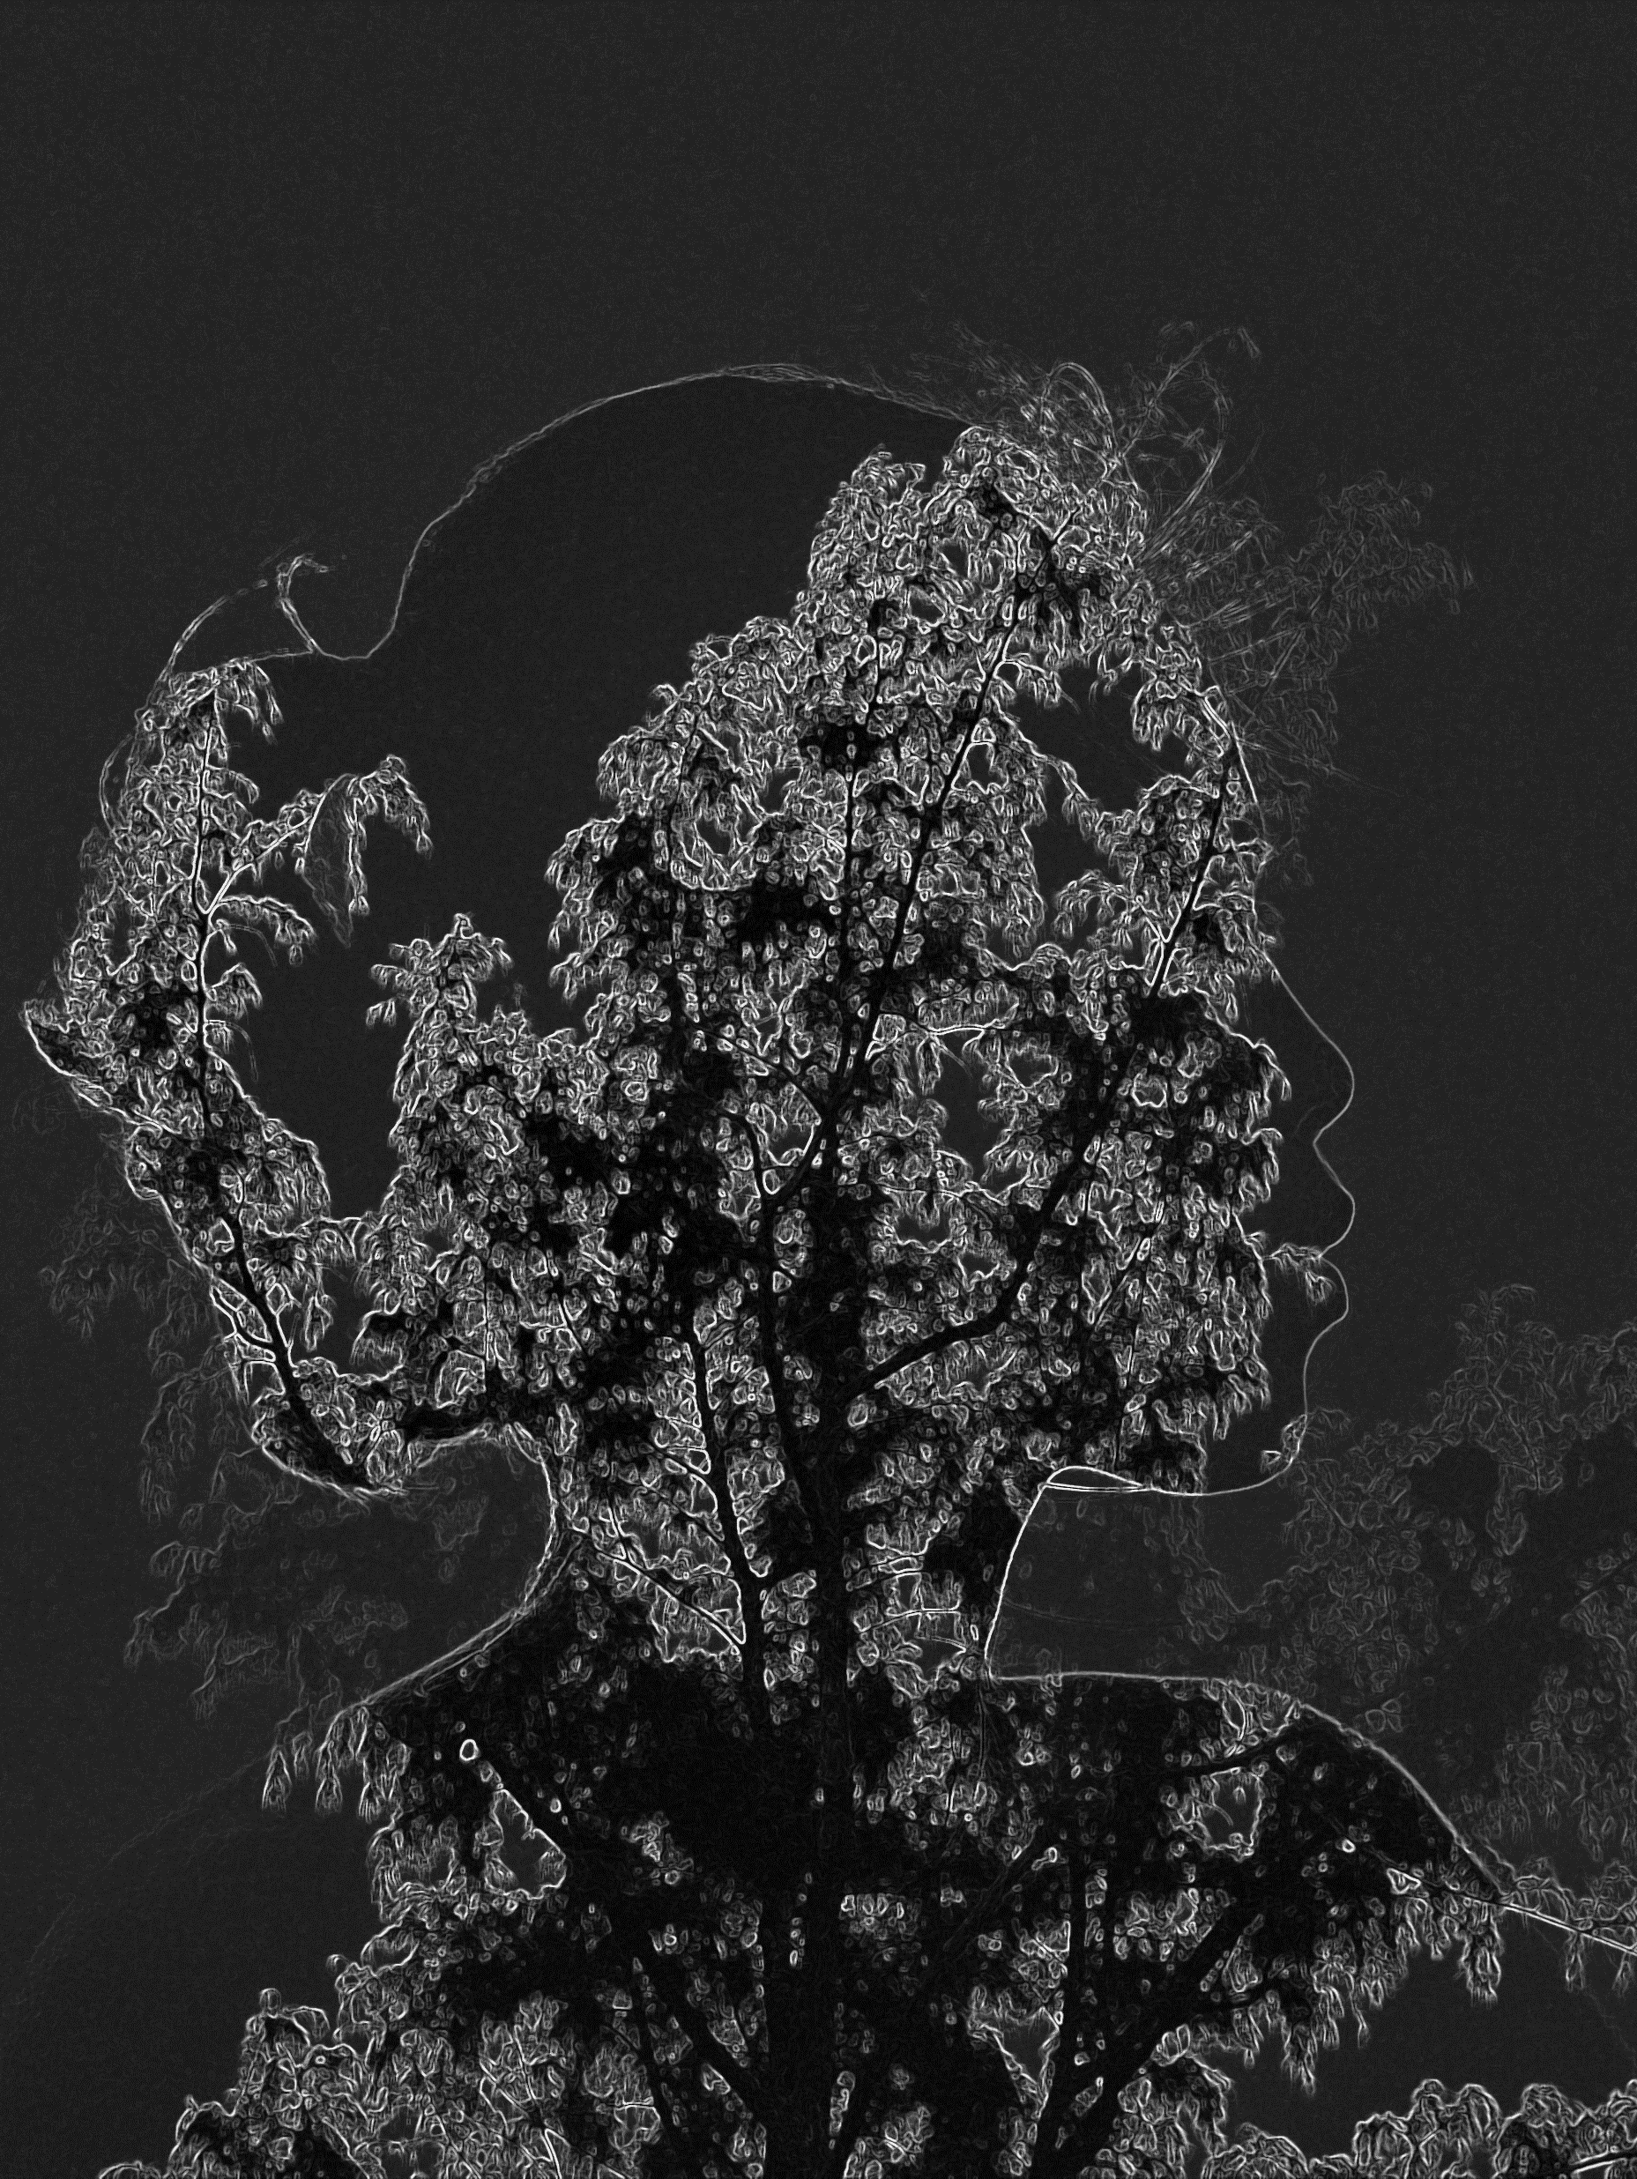
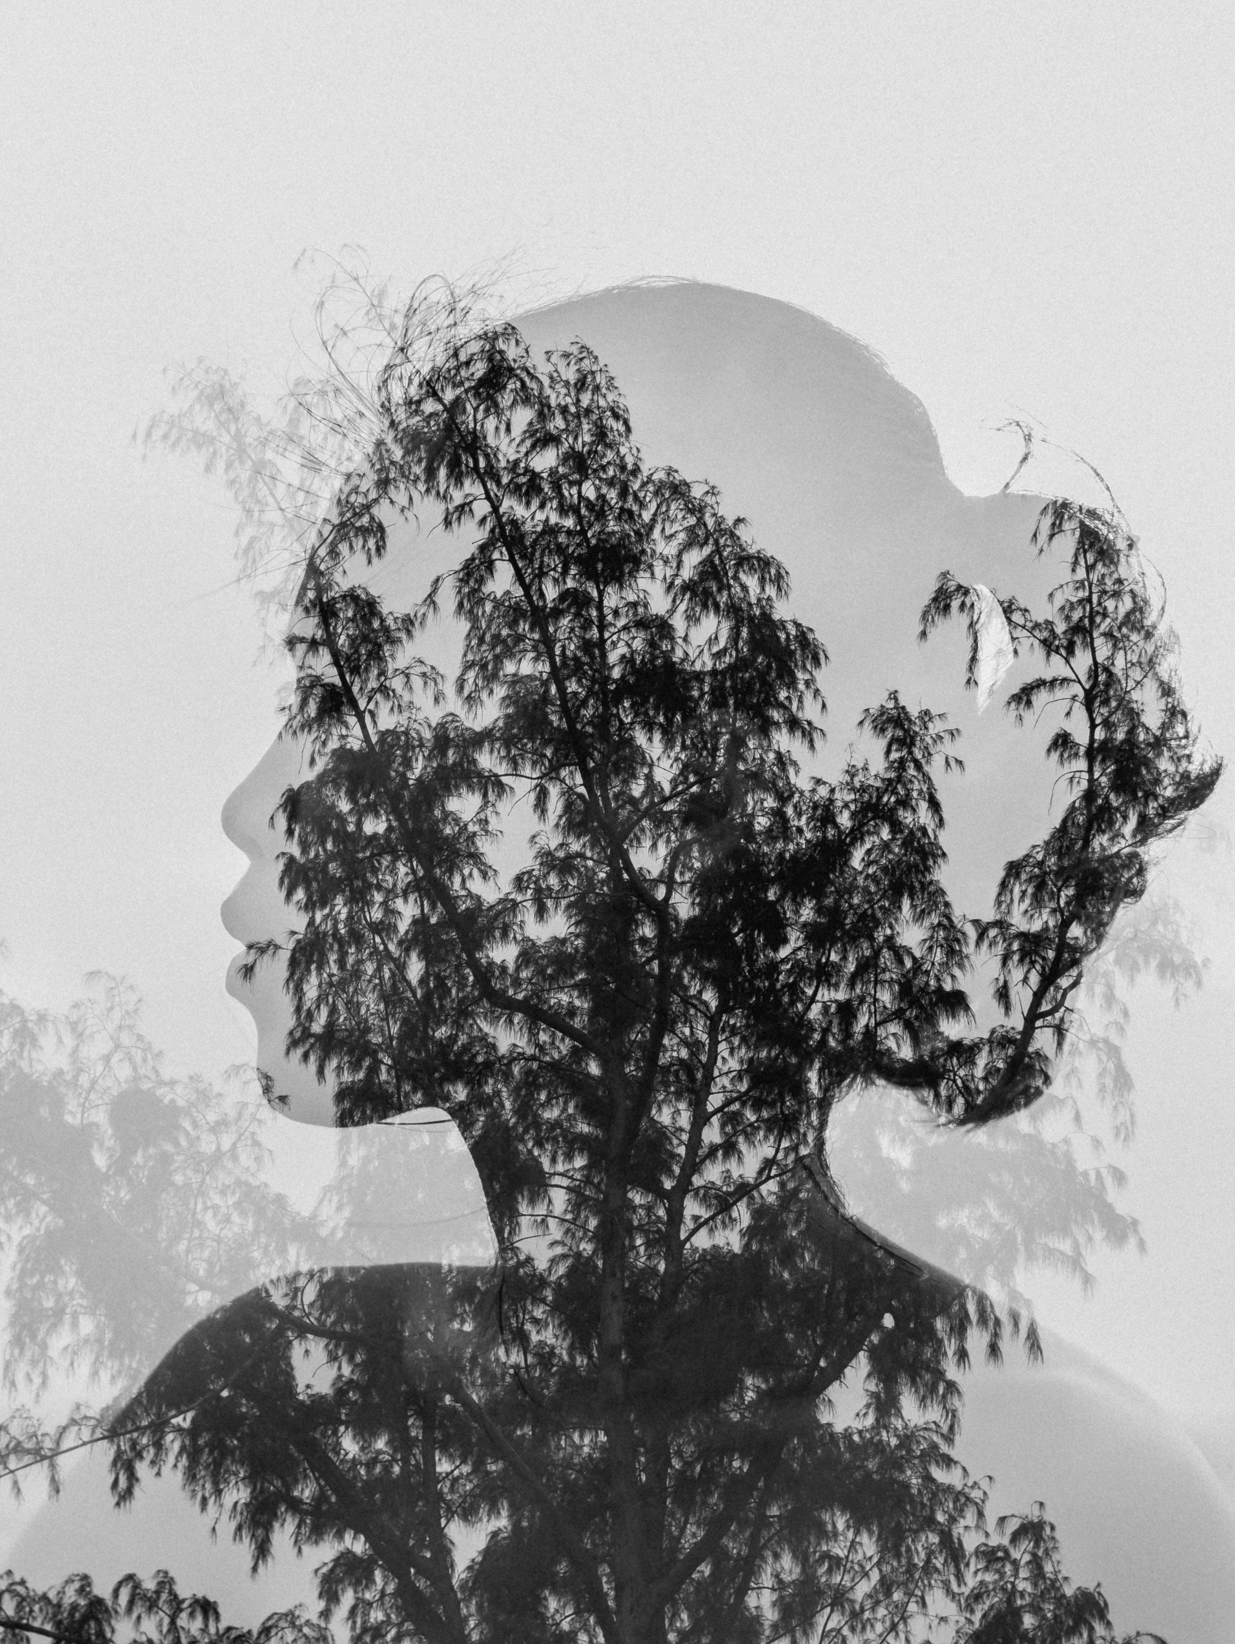
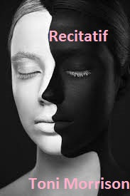
Sara Bibeau
ENGL287C-ZZ
Prof. Paula DelBonis-Platt, Ph.D.
Questions and Questioning in Toni Morrison’s “Recitatif”
Sara Bibeau
ENGL287C-ZZ
Prof. Paula DelBonis-Platt, Ph.D.
Twyla first introduces Maggie and the orchard in the narrative; she recalls Maggie falling, the older (gar) girls laughing at her (2). Twyla says she used to dream a lot, and often the orchard was in those dreams, wondering “… why I dreamt about that orchard so much. Nothing really happened there. Nothing all that important, I mean” (2), a dismissive foreshadowing.
In one encounter as adults, the orchard comes up. Twyla recounts the incident as paraphrased previously. Roberta counters her memory, saying the gar girls “… pushed [Maggie] down and tore her clothes” (12). Twyla insists she has no memory of it happening that way. As the two part she thinks, “Roberta had messed up my past somehow with that business about Maggie. I wouldn't forget a thing like that. Would I?” (13); a signifier of inner conflict
The next conflict revolves around racial strife and a bussing issue that results in a protest; here the Maggie memory dichotomy morphs again (14). Roberta now insists it was they who had kicked Maggie, adding in her race as black, countering Twyla’s earlier memory of Maggie as “sandy colored” (1), another counter-memory.
In the essay “Memory as Construct,” Melanie Altanian writes that “For memory to be successful (rather than distorted) means to remember in ways that aim at truth and are guided by the virtues of accuracy and integrity” (15). This idea is at play with Morrison’s use of counter-memory in these scenes.
Introduction
Morrison employs the concept of counter-memory to challenge established historical narratives and introduce alternative perspectives that contradict conventional assumptions about the past.
This use of counter-memory not only challenges the characters' own perceptions of themselves and their past but also prompts readers to reconsider their views on race and its role in society.
The short story "Recitatif" by Toni Morrison features two women, Roberta and Twyla, of undisclosed racial backgrounds, whose relationship begins in childhood and evolves over time.
Throughout the story, Roberta and Twyla experience moments of estrangement and reconciliation, grappling with memories of their shared history.
Morrison uses thematic conflicts, particularly involving the character of Maggie at the children's home, to explore the complexities of memory and identity within the context of the story.
The ambiguity surrounding the racial identities of Roberta and Twyla encourages readers to engage with Morrison's counter-narrative, prompting them to reevaluate their understanding of race and its implications.
Conclusion
At the end, each of the characters has revealed two truths: one, that they cannot recall Maggie’s race with certainty, and two, though they know they weren’t the ones to kick her, they had each wanted to. Maggie’s race stays ambiguous, leaving the reader with another thought: does how we feel about these unanswered questions create a narrative that runs counter to what we may have thought about ourselves and our perceptions on race and memory before having engaged with this story? The admission and acceptance of how they felt hits hard, as Roberta cries, asking, “What the hell happened to Maggie?” (14). Despite the years in between their meetings and the tension with each, this formative shared experience with Maggie in the orchard represents the fraught relationships with themselves and their childhood, the role of race in their lives, and ultimately how these counter-concepts can lead us to deeper understandings of ourselves as women and people. The reader ends the story reflecting on their own memories, tenuous or solid, wondering what the hell has happened to any of us.
Some words on the role of counter-narrative: Once the scene at the bussing protest begins to unfold (14), an active reader might find themselves with a sense of unsteadiness, questioning what is true and what is important in the story; is it these women’s stories or how the reader is perceiving their races that should be focused on? A counter-narrative begins to emerge as Maggie’s race is suddenly called into question. Is Morrison asking the reader to question what importance race has within the story in a second way, begging us to search deeper still? Juda Bennet points out that this story “… refuses to solve the mystery of racial identity and instead asks its readers to examine the importance they place on fixing racial identity, hardly allowing them to remain passive readers or disingenuously uninterested” (213), and as such, is there really one true way to answer it?

